Slide 1
Future Homes: From ambition to prototype to mainstream
Professor Rose Gilroy
School of Architecture, Planning and Landscape
Newcastle University
r.c.gilroy@ncl.ac.uk
@profroseg

Slide 2
Defining the challenge

Slide 3
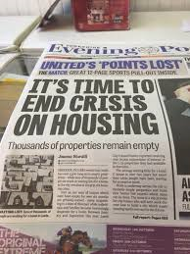
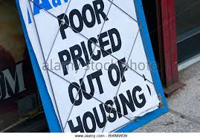
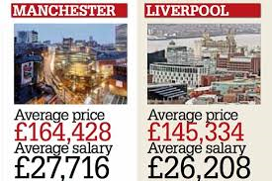
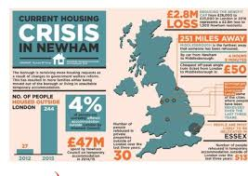

Slide 4
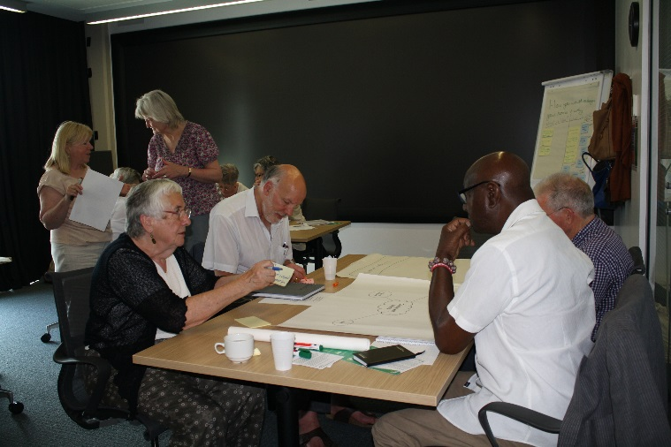
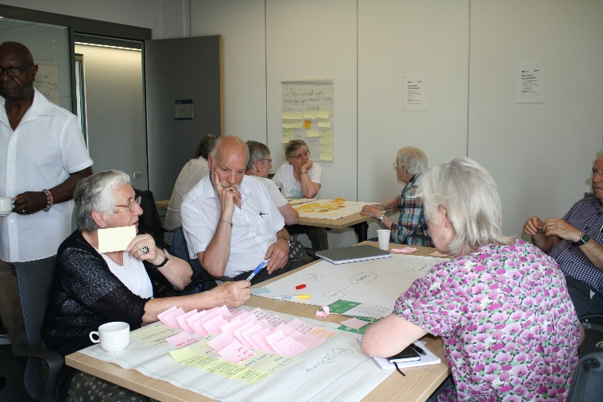
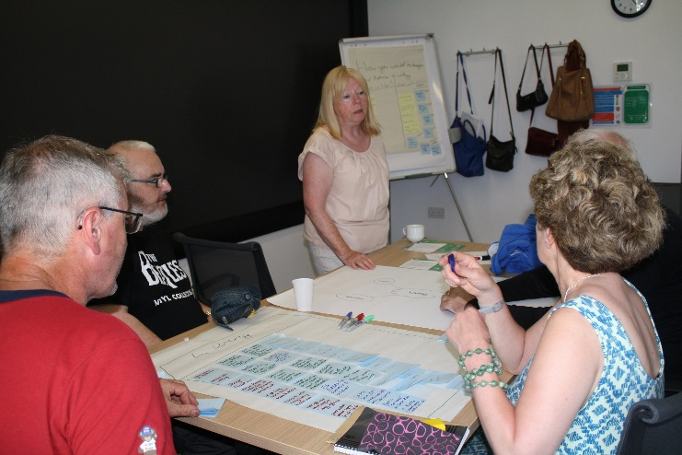
Demographic Change
By 2037 people aged 65+ will account for 25% of the UK population
By 2035 over 3 million UK citizens will be aged 85+
People aged 50+ hold;
68.3% of UK household wealth (£7.8 trillion)
77.3% of all financial wealth (£1.2 trillion)
66.2% of all property wealth (£2.5 trillion)
The growing older population is increasingly diverse with changing lifestyle demands and housing needs
Notes:
4
As research has constantly proved the suitability of an older person’s home plays a critical role in maintaining their independence and wellbeing with improvement of mainstream homes, development of specialist housing and provision of housing related support all contributing to efficiency savings and demand on health and care services. Depressingly much of the UK’s housing is not serving current nor future needs:
Around 20% of dwellings occupied by those aged 65(+) have no accessible features meaning that their ability to age well in their current home is diminished.
Targeted housing for older people in the UK is depressingly polarised with an emphasis on “care”; responses based on meeting need not aspiration with poor recognition of the shifting expectations of a growing market. More than 4 million older households wish to move but annually only 4% do so suggesting a paucity of acceptable options.
We also cannot ignore that many younger people are priced out of all private sector housing (both rental and purchase options) and have to live with their parents.
The challenge then is to respond to aspiration as well as need; to build for all ages and to deliver affordable options.

Slide 5
Changing face of older people

Slide 7
Mosaic/Experian has 16 categories of retired people
L50 Pocket Pensions
L51 Aided Security
L52 Estate Veterans
L53 Seasoned Survivors
M54 Down to Earth Owners
N57 Community Elders
N60 Ageing Access
B06 Diamond days
B09 Empty Nest adventures
C13 Village Retirement
D16 Outlying Seniors
E18 Legacy Elders
E19 Bungalow Heaven
E20 Classic Grandparents
E21 Solo Retirees
L49 Dependent Greys
Experian Generation 6 Data Profile 2017

Slide 8
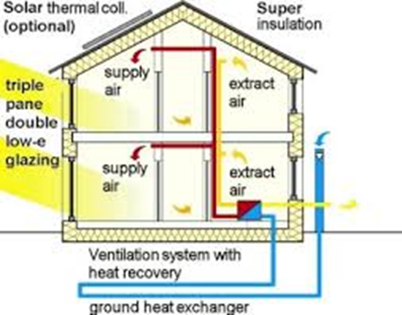
Climate Change
Air pollution costs the UK £54 billion per year and causes 680 deaths in North East
By 2050, 3.2 million people will be at risk of surface water flooding in urban areas
Heating and hot water for buildings make up 40% UK energy use and 20% greenhouse emissions
Excess winter deaths and dealing with excess heat
Notes:
8
The evidence that our climate is changing is undeniable and we have come to realise that our housing is both a contributor to green house gas emissions and also at risk from the consequences. The likelihood of fuel outages increases while for low income and vulnerable people there is the misery of cheerless cold housing and fuel poverty with impacts on health and well-being.
The health impact of unburnt hydro-carbons in our air are becoming more clear and there is a pressing need to take action.
The challenge is to take a whole systems approach to materials, energy systems, water and waste and to make responses to the new discourse of the circular economy through reuse, remanufacture and resource efficiency.

Slide 9
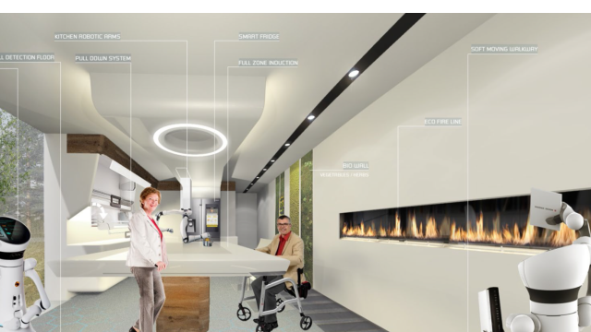
Digital Innovation
As lifestyles become more demanding, people expect more from their homes. Housing has been slow to embrace digital innovation
By 2030 there will be 2 million people aged 65+ without adult children to look after them. About 230,000 will need more than 20 hours care a week without informal support
Notes:
9
While the role of technology in well-being is often considered to encompass falls monitors, telecare, telemedicine and monitoring devices intended to support the frail and particularly the cognitively frail, the role of technological support available to us in our homes is potentially far wider than this.
The so-called ‘Internet of Things’ IoT is evolving rapidly. At its most future-looking, it can mean about connecting white goods such as fridges to the Internet so that they can, for example, automatically order more milk. However there are more immediately useful IoT applications that are closer to market, such as boilers which automatically inform a servicing company when they develop a fault.
The challenge is to explore what is needed as well as what is possible to develop attractive, useful and discreet support that can be added to as needs change.

Slide 10
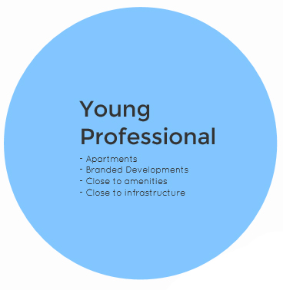
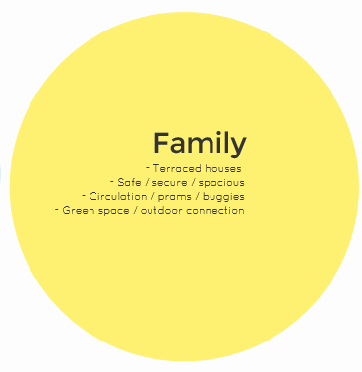
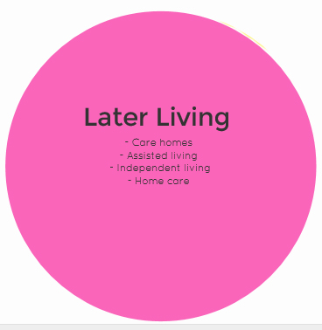
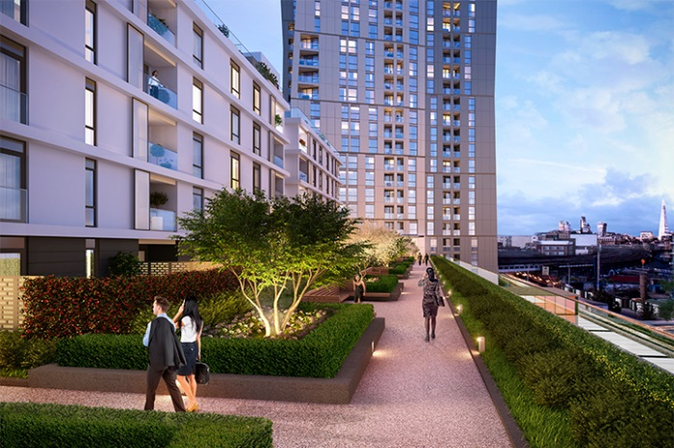
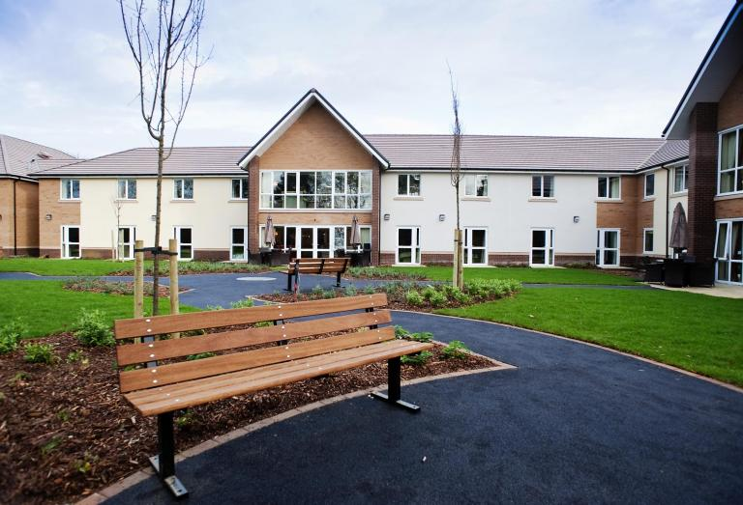
Housing: The market response
The usual response
Notes:
10
Images can be placed full screen then “sent to back” (right click on image, click on “order”, then “send to back”)

Slide 11
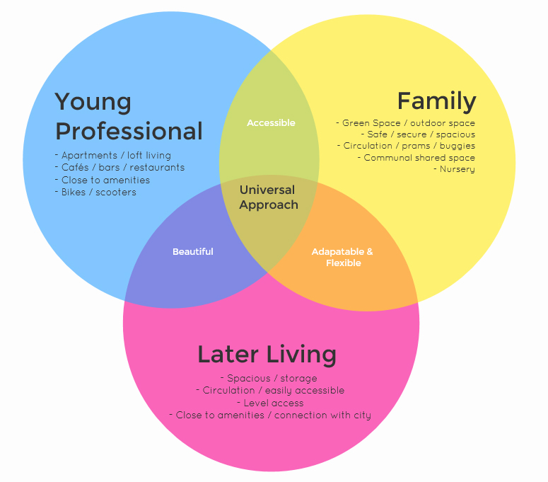
More in common
Taking a universal approach
Notes:
11
Images can be placed full screen then “sent to back” (right click on image, click on “order”, then “send to back”)

Slide 12
Thinking afresh

Slide 13
Open Innovation
Quadruple Helix Model where local government, business, university and community work together …
… to co-create the future and drive structural changes far beyond the scope of what any one organization or person could do alone.
University
Local Govt
Business
Community
Notes:
13
In responding to these challenges we have committed ourselves to an open innovation model of working that recognises that our capacity to understand the problems; to envision innovative solutions and capacity to take action through multiple funding opportunities happens best when we work together. In Newcastle we have pioneered this model through the urban living partnership Newcastle City Futures. Under that umbrella I invited a range of respected and highly placed organisations and individuals to join me in envisioning our future housing.
This open innovation model is significant not simply as a means of generating the initial concept and moving the project from inception to completion but as a process of co-creation that opens out to the public and industry working always to make Future Homes meaningful and visible. More of this later.

Slide 14
National Innovation Centre for Ageing
Notes:
14

Slide 15
Single Vision
Ageing
Digital Innovation
Urban Sustainability
Future Homes
Notes:
15
The aim of our group is to recognise and respond to the complexity of urban life so we cannot confine our solutions to one challenge but need to find ways of fusing multiple responses together into dwellings that can feel like home.

Slide 16
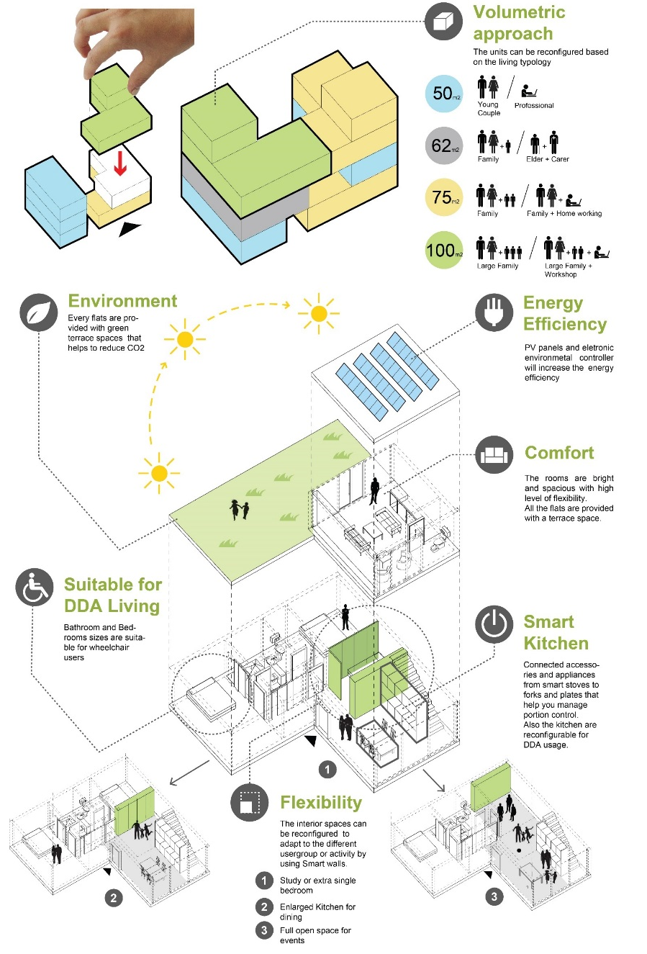
Single Vision
New housing exemplars that show a vision for the future
Innovations in prefabrication, flexible living, materials, digital and low energy technology to provide supportive homes for everyone, at any stage of life
Public dialogue and expert collaboration to drive the best ideas and opportunities, tested and showcased in demonstrator units
Notes:
16
So this is our vision.

Slide 17
What innovation is out there?
Co design, public engagement
Community health professionals
Democratising design
The known
End users
OTs etc.
Experiences
benefits Challenges to industry
Notes:
More specifically we are scoping the innovations that have been discussed in journals both academic and professional - what solutions have been tested with what results. We have a planned series of workshops with those health professionals who go into people’s home when the person and their environment no longer comfortably fit together because of some trauma or illness. Working with Ryders, the professionals will be invited to share their experience so we can ensure that more of their knowledge is incorporated into our design from the start.
The big piece of work is with end users in a co-design mode broadening out to greater pubic engagement and Peter will take up the story here.

Slide 18
From insights to industrial challenges
2017: From user insights to challenge led solutions
Insights:
User experiences and desires
Solutions:
Including enabling technologies
Innovation Gap
Benefits:
Outputs to be determined
Notes:
We aim to be on site this time next year and in the intervening 12 months we have an ambitious programme of work that involves gaining critical insights from a range of stakeholders and translating these into challenges for industry looking to bridge the gap between what is needed and what is possible.

Slide 19
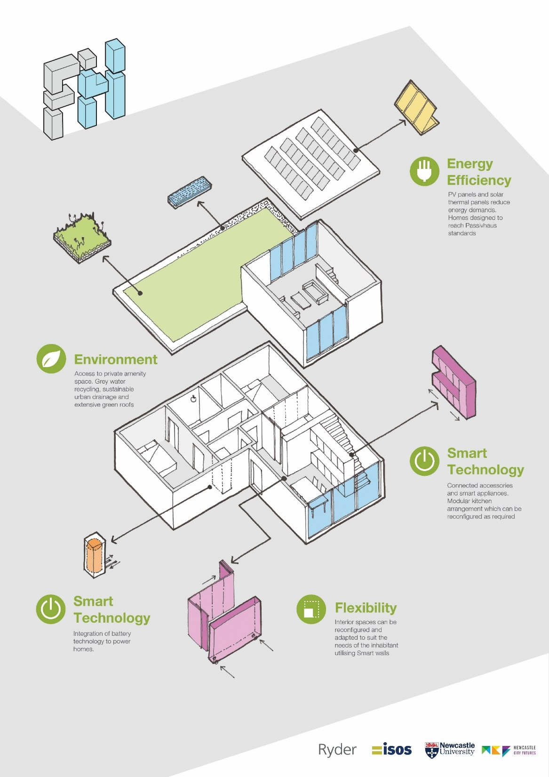
Making it real
Four dwellings to be built in 2018 grant aided by HCA
Rented via Karbon Homes, with occupiers contributing to Post Occupancy Evaluation
Learning from this phase will inform the extension development of 30 units in 2019
Possibility of developing on the bigger scale
Notes:
19

Slide 20
Thoughts to date
Shy bairns get nowt -If you’re going to have a dream- make it a big one
Cross sectoral partnership working opens more doors
Need to be multi lingual- WIFM

