Slide 1
Henley Healthcare Investments
Laura Fortune : Client Relationships- Health
July 2017

Slide 2
July 2017
The HHI Service
Henley Healthcare Investments (HHI) is part of the Henley Investment Group.
Supported Housing for Adults with Learning Disabilities, Mental Health and / or Physical Disabilities.
Since 2013, HHI has invested over £200m into housing for vulnerable adults across the spectrum of need including substance misuse and homelessness.
Over 1000 tenancies across 400+ projects across England.
Notes:
Updated on 04-04-17

Slide 3
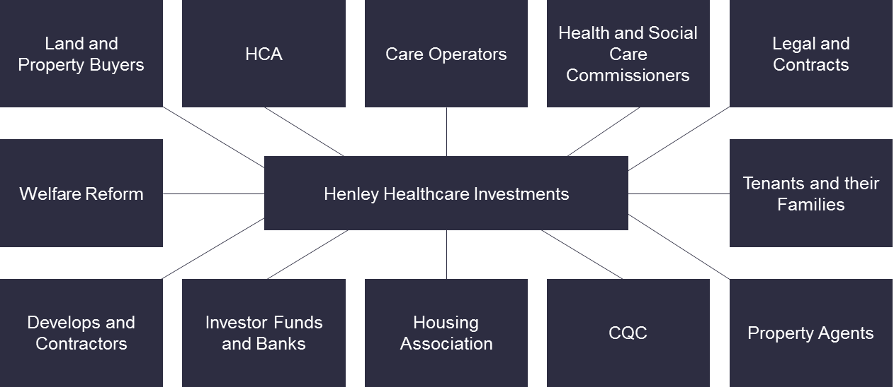
July 2017
A Collaborative Approach
Text
Notes:
Updated on 04-04-17

Slide 4
July 2017
An Investor’s view point
Meets gap in the housing market
Examples of where this arrangement has produced cost savings
Defined responsibilities between housing and social care
Promotes independence for clients
Experience and knowledge of housing, health and social care commissioning
Responsive
Notes:
Updated on 04-04-17

Slide 5
July 2017
How Investors can help accelerate supply of specialist housing
Commissioners share TCP housing strategy, inc. geographic demand, specific needs etc.
Team dedicated to property searches from wide range of sources, developers, commercial and estate agents
Acquisitions of portfolios stock, no longer fit for purpose care homes which can be de-registered, redesigned to supported living
Homes designed to specific needs
We can be a delivery partner for the supply of housing
Notes:
Updated on 04-04-17

Slide 6
July 2017
Business Model
Private Investor leases to Registered Housing Provider(s)
RHP holds the lease for period of 25 years
Nomination Control - can be held by Local Authority and/or NHS. This gives flexibility to commissioners for selecting providers from framework.
If commissioned directly by a Care Provider , this gives rights to the care provider to control the use of the building and thus secure ongoing business.
Voids- Rent free periods to allow managed fill up and when/if there is a change of tenant
Notes:
Updated on 04-04-17

Slide 7
July 2017
Further information
Building the Right Home
https://www.england.nhs.uk/learningdisabilities/wp-content/uploads/sites/34/2015/11/building-right-home-guidance-housing.pdf
How HHI can help: contact: Laura Fortune Client Relationship Manager – Health
laurfortune@henleyhi.com
www.henleyhi.com
Notes:
Updated on 04-04-17

