Slide 1


Eastern Region Housing LIN
Friday 30th June
A Private Sector View
Developing Partnerships
to deliver
Healthcare and Housing projects

Slide 2
Presentation contents
Shared values and Social Impact
Competitive procurement – is it necessary?
Locally based modular factories, local houses built by local people
Grimsby Open Door Welfare Centre offering direction and support
HAPPI principles at Strand Court, Grimsby and Harwich Extra Care
Working with Construction Companies
Doctors’ surgeries designing to BREEAM and delivering social impact
Integrated Pathology Partnerships
HSN (High Support Needs) partnership
LIFT (Local Improvement Finance Trust) in Walsall
Partnering to develop and deliver
Local Authority bid successes, awaiting the new funding model
Defining real value and developing partnerships

Slide 3
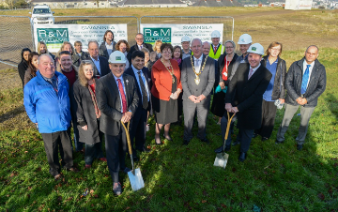

Founder members of the
Social Stock Exchange
  Exploring shared values and vision
  Community focused housing
  Improving people’s lives
  Embracing a ‘can do’ attitude
  Looking to regenerate localities
  Delivering a significant Social Impact

Slide 4
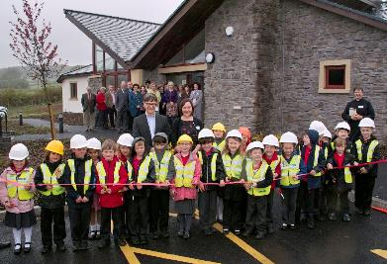
Competitive procurement
Is it necessary?
Ministerial mandates and manifestos – nothing is certain!
Elections, elections, elections… OJEU, where to now post Brexit?
JV arrangements – working collaboratively with Local Authorities
Having long term investment intentions and share capital
Jointly represented Project Board
Collaborative working
Best consideration for LA land
Delivery for the social good

Slide 5
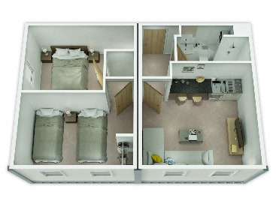

Locally based
Modular Factory proposals
A locally based factory on Council-owned land
Local labour hired and trained to work to our approved systems
One stop shop JV solution to Councils
Local houses built by local people
  A continuous supply of housing
  General needs, affordable homes
  Homes with access to care of any complexity
  Tackling the homelessness agenda

Slide 6
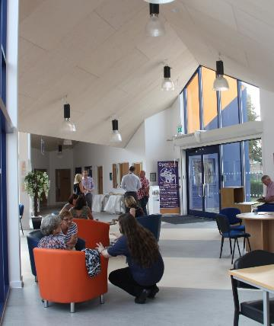

Grimsby Open Door Welfare Centre
A local social enterprise delivered by a localised Public-Private Partnership
Full range of social welfare and health services under one roof
Open to everyone in the community
Support for those with additional complex needs
Help for the homeless and those living with addiction
Direction for people looking for employment or volunteering opportunities

Slide 7
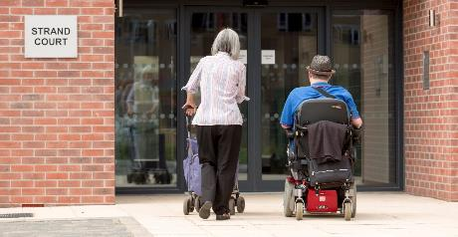

Strand Court, East Marsh, Grimsby
JV with CCG for delivery of 5 schemes
300 Extra Care apartments planned
Clients receive care and support in their own homes
First scheme, 60 flats at Strand Court
Fully catered dining area
Communal meeting zones
Strong sense of community
Desire to stay in the area

Slide 8
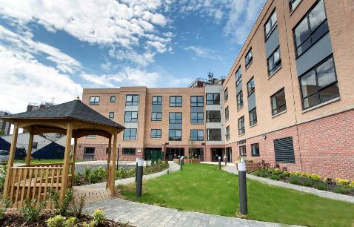
HAPPI principles
Providing an attractive alternative to the family home
Space, flexibility and natural light, avoiding internal corridors and single-aspect flats
Incorporating Telecare and Telehealth
Circulation spaces to encourage interaction avoiding an ‘institutional feel’
Shared facilities and community ‘hubs’
Plants, trees, and the natural environment
High energy efficiency, and good ventilation
Extra storage for belongings and bicycles
External shared surfaces and 'home zones'

Slide 9
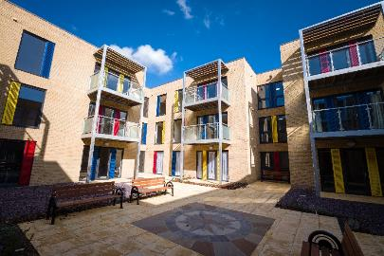
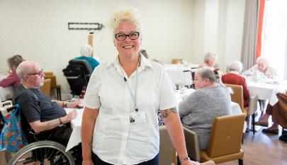
Harwich Extra Care in Essex
One of two Local Authority grant-supported schemes
Local Authority and Registered Provider partnership
First two ECH schemes in Essex
58 apartments built over 3-floors
Residents’ lounge, restaurant and private courtyard garden

Slide 10
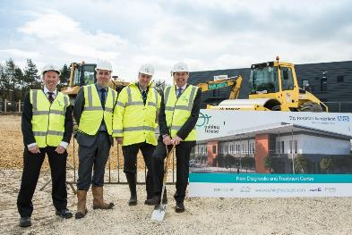




Working with Construction companies
S106 affordable requirements
Self-contained Extra Care complex providing affordable offset
Landscaped community feel
Management of associated facilities
Positive impact on market values, funding the affordable

Slide 11
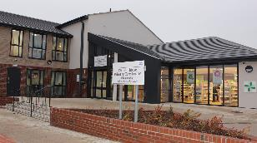
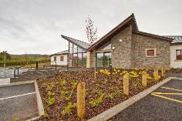
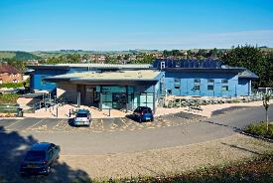
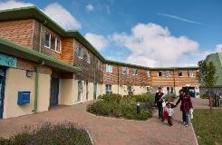
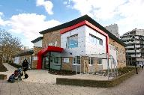
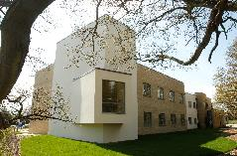
New Doctors’ Surgeries, delivering a significant social impact
Chapel House, working with Doctors, the NHS and community stakeholders in Newcastle-upon-Tyne
2x GP Practices working side by side
Designs to BREEAM very good or excellent
Pharmacist and other healthcare providers
Community based facilities regenerating the area

Slide 12
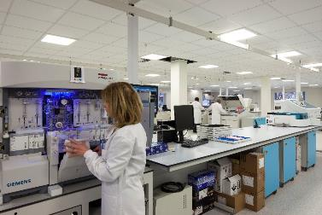
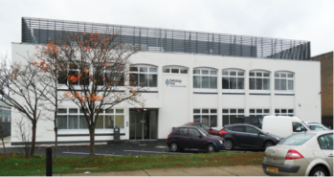


Integrated Pathology Partnerships
New bespoke high tech laboratories, leading the way in Europe
Conversion of disused industrial building
Hub and spoke model releasing Hospital space
Hospitals able to retain essential service labs
Space released for expanding care services within the hospitals

Slide 13
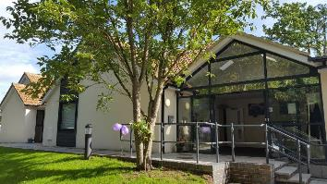
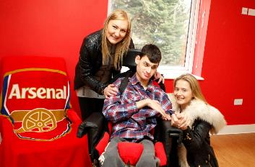

HSN (High Support Needs) partnership
12 enabled living service homes for adults with Profound and Multiple Learning Difficulties
All bedrooms have en-suite wet rooms with state-of-the-art hoist system in all living areas
Residents maximise potential and enhance their life experience
Taking control of their own lives

Slide 14
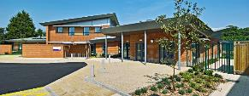
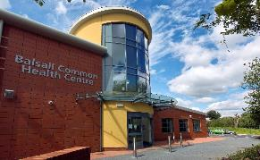
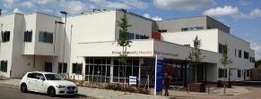







Local Improvement Finance Trust
Seven Public Private Sector LIFT partnerships across the UK
Delivery of new projects
Management of LIFT estate
Feasibility studies and option appraisals
Service and Estate planning
Rigid governance, benchmarking and KPIs delivering value for money

Slide 15
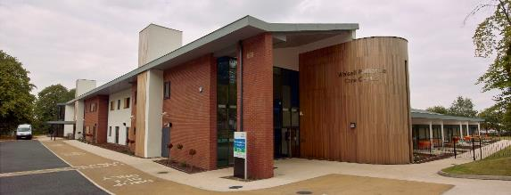

Goscote Palliative Care Centre
The first dedicated hospice facility for adults within Walsall
Implementation of Walsall’s new End of Life Strategy
2,500m² including 12 in-patient Hospice beds
Day Hospice and a range of Palliative care support services
Complementary therapies and out-patient rehabilitation

Slide 16
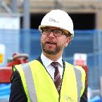
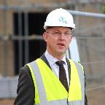
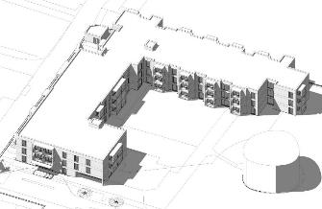

Partnering to develop and deliver
Bringing together and managing participants
Aligning agendas, finding common ground
Ironing out barriers to progress
Managing architects and construction companies
Driving in best value and design

Slide 17
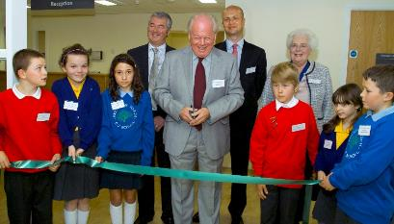
Local Authority bid successes
Stalled due to Government changes in treatment of supported housing and exempt accommodation
New funding model promised in the Autumn
Ring-fenced funding to Local Authorities
Local decisions on allocation
Elections, elections, elections…

Slide 18
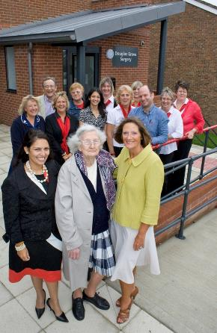
Defining real value
Beneficial social impact v. financial gain
Delivering infrastructure to benefit the Community
Joint ownership of a project
Finding common ground
Maximum social gain

Slide 19
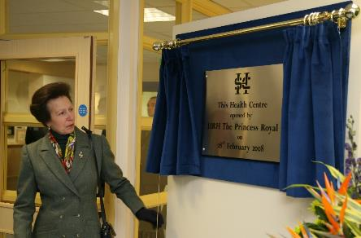
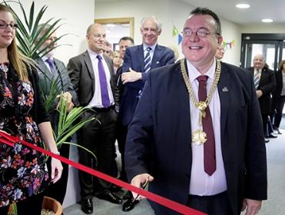
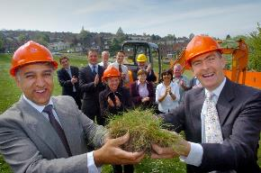
Developing Partnerships
Dependable communication
Relationship building
Evolving trust
Patience and time

Slide 20



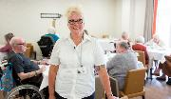
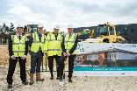
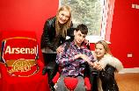
Thank you for listening
Richard Warner
rwarner@ashleyhouseplc.com
07831 641350
www.ashleyhouseplc.com

