Slide 1
Housing LIN East
30 June 2017ue.Ramsden@housing.org.uk
Sue.Ramsden@housing.org.uk Helen.rowbottam@housing.org.uk
Notes:
Welcome

Slide 2
Why a new funding framework?
Universal Credit
Controlling costs
Local decision making
Better use of public money
Local Housing Allowance cap
Notes:
Why are we talking about a new funding framework?
What’s the context?
The roll-out of UC, which will encompass housing costs, means that the HB system will be phased out and an alternative is required.
Not how we might design a system from scratch…

Slide 3
Working age people NOT in Specified Accommodation
(£0.30bn – 32,000 SH units)
HB spend in
SH per annum
in Great Britain
Older people NOT in Specified Accommodation
(£1.67bn – 359,000 SH units)
Working age people in Specified Accommodation
(£1.42bn – 157,500 SH units)
c£4.12bn
Older people in Specified Accommodation
(£0.73bn – 103,000 SH units)
Older people vs working age Supported Housing spend and units
Specified vs non Specified Accommodation spend and units
Working age people
(£1.72bn)
Non Specified Accommodation
(£1.97bn)
Older people
(£2.41bn)
Specified Accommodation
(£2.15bn)
Outer pie: % of total SH HB Spend
Inner pie: % of total SH units
Outer pie: % of total SH HB Spend
Inner pie: % of total SH units
Sources: Local authority survey, provider survey and CORE Social lettings 2014/15 (DCLG). Base: 177 Housing Benefit team respondents, 83 Commissioners and 65 providers across Wales and Scotland.
Notes:
This final chart show the breakdown of Housing Benefit spending on rents and eligible service charges. These figures were key for Government in informing the decision made about the future funding system.
Some of the cost data in the report is split between specified and non specified accommodation. Specified accommodation is the definition of supported housing in benefits regulation and is a more specific definition than used across the housing sector for homes designated as ‘supported or sheltered housing’. Government was interested in investigating the costs of this subset of housing where support services and costs tend to be higher. The Federtation has suggested that these estimates significantly undercount the numbers as it is difficult for local authorities to identify specified schemes and no comprehensive exercise to classify schemes has ever taken place.
Looking at the chart in the bottom left hand corner of your screens this shows in the inner circle the split of properties between older people amd working age people. And on the outside in the grey and red is the split in terms of the housing benefit bill. Older people – 71% of stock 58% of HB bill.
I will now move on from the research to look at the consultation paper.

Slide 4
(*%)
Source: Local authority survey. Base: 83 Commissioners. Fieldwork dates: 19 October – 2 December 2015

Slide 5
How will schemes be funded?
LHA Cap
Support
and/or
care costs
Now
Rents and service charges
Other Funding
Local Funding
DWP Funding
RINGFENCED
Support
and/or
care costs
2019 -
Rents and service charges
Notes:
This diagram represents the changes from the existing to the new system.
The current system broadly pays rents and HB eligible service charges through HB as long as the tenant is on a low income. Support and care costs are then commissioned separately. Many tenants pay some or all of the rent and service charge themselves – this is more likely to be the case in sheltered housing schemes.
The proposed system will pay the tenant housing costs up to the LHA cap level. This will be through Housing Benefit or Universal Credit and costs will have to be eligible according to the rules of these benefits.
Funding for costs above the LHA cap level will be available locally and this money will be ring fenced to pay for supported housing. Care and support costs will be funded locally as at present though local authorities may want to look at how commissioning of the housing care and support work together.
This is not to scale! The LHA cap will vary from area to area, and the amount of top up will vary from area to area and by scheme type. This is purely illustrative to show the various elements that make up the funding for a scheme.
5

Slide 6
Concerns from housing providers
Loss of certainty for future development
Variation in LHA cap
Security for tenants
Loss of funding for housing costs
Retaining the ring fence
Notes:
Fed response - We welcomed:
No LHA cap until 2019
No Shared Accommodation Rate
Pledge to fund housing costs to the same extent as they are currently
The ring-fencing of funds
Uncertainty for customers

Slide 7
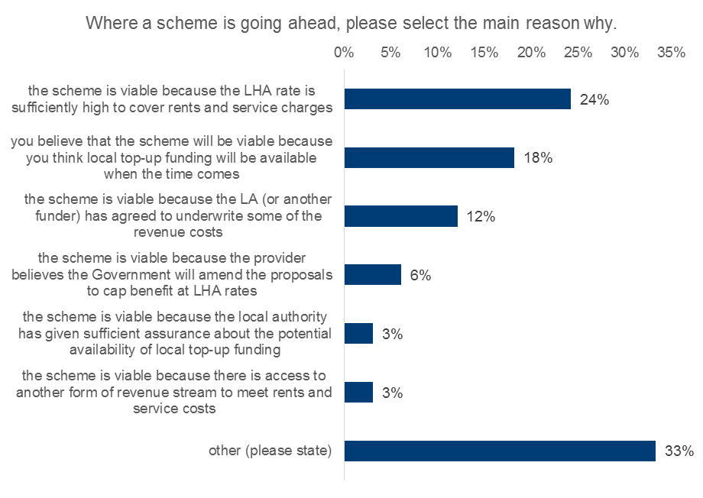
Reasons that schemes are going ahead

Slide 8
What would give you certainty?
Rank | Area of certainty
1 | A higher cap than the local housing allowance level that meets a greater proportion of the rent/service charge
2 | A long-term commitment (set out in legislation) on the part of Government to maintaining any ring-fence
3 | Adequate funding for local authorities so they can fund existing schemes on day one
4 | A sheltered housing allowance that is higher than LHA for older people in sheltered housing
5 | Statutory duties to protect vulnerable residents
6 | A national outcomes framework for the Governments proposed system
7 | A test and learn pilot approach to the proposed new model

Slide 9
New personalities (again…)
Notes:
Alok Sharma
MP for Reading West
No real background in housing but was member of bow group (oldest Conservative think tank). Two years ago Bow Group was supportive of the principle of housing associations, arguing that the Government should not interfere with them.
Career in corporate finance before becoming an MP
Been on Treasury Select Committee and Science and Technology Committee
Voted consistently in favour of benefit cuts
Caroline Dineage
MP for Gosport from 2010
Minister for Family Support, Housing and Child Maintenance, and has the supported housing brief
Formerly Minister for Women, Equalities and Early Years at the Department for Education from 17 July 2016 to 14 June 2017.
Voted for cuts to HB for people living in supported housing – in June 2016
Consistently voted to reduce spending on welfare benefits
David Gauke
MP for SW Hertfordshire
Solicitor in financial services until 2005
Never seemed particularly bothered about how supported housing was funded, only how much it would cost
Consistent record of supporting cuts to welfare benefits spend

Slide 10
New power of the back bench MP?

Slide 11
Joint inquiry findings
A new supported housing allowance which is banded to reflect the actual cost of provision in the sector
A new capital grant scheme to ensure core rent and service charges for new supply
The Government to guarantee the ring-fence around local authority top-up funding for the duration of the next Parliament
An alternative funding mechanism for short-term schemes
Pilot
National standards
Notes:
A new supported housing allowance which is banded to reflect the actual cost of provision in the sector
A new capital grant scheme to ensure core rent and service charges for new supply would remain broadly consistent with existing stock.
The Government to guarantee the ring-fence around local authority top-up funding for the duration of the next Parliament, and a clear indication of its desire for the fund to remain in the long term.
An alternative funding mechanism for very short-term accommodation,
The scheme to have a proper pilot.
The Government should establish a set of national standards

Slide 12
Sheltered housing is important
£300m per year from reduced length of in-patient hospital stays
£12.7m per year from fall prevention by residents of sheltered housing
£156.3m per year from prevention of falls which result in hip fractures
£17.8m per year from reduced loneliness experienced by residents
Notes:
Although I am talking about supported and sheltered housing – not just older people’s housing – it is important that we think in this broader context as this is how the Govt is viewing (and asking) the question
Sheltered is seen as a bit of an after thought and a problem to be solved – but there is still hope that Govt will consider a slightly different approach for this type of housing
Housing associations provide 422,000 specialist homes for older or vulnerable people who need extra support

Slide 13
Starts at Home campaign

Slide 14
Step down care
Existing best practice from housing associations

Slide 15
Curo Step Down Scheme (Bath)
Six self-contained one bedroom flats or bungalows
Dedicated support and access to 24-hour care team
Provided within or adjacent to extra care hubs
‘Free at the point of delivery’ 7 days a week
Transport from hospital available
Outcomes:
Every year, 20-30 enabled to live independently
In 2015/16 the service saved 1,854 excess bed days
Cost benefit of £561,762 for the NHS in 2015/16

Slide 16
Wigan and Lee
A specialist housing advisor assists people with housing issues at point of hospital admission. Ongoing support with:
access to temporary accommodation in a crisis
first point of contact when housing-related issues arise
identifies personalised housing solutions
Outcomes:
Cost benefits of £644,300 in savings over a two-year period based on 800 excess bed days saved.
Person-centred approach reflects the needs of specific clients

Slide 17
Staffordshire Housing Group
Bedside assessments within 2 hours of referral
‘Meet-and-greet’ service - for patients requiring immediate support at home
Home visit for all patients within 48 hours of discharge
Outcomes:
92% of people were not readmitted to hospital
25% reduction in delayed discharge = £320,000 p.a. excess bed days savings;10% reductions = £130,000 p.a. savings
98% of patients would recommend the service

Slide 18
Nottingham City Homes
Hospital to Home/Housing Health Coordinators (HHC) scheme
Supports people affected by poor or inappropriate housing transition from a reablement bed to self-care/supported living at home
Funded by Nottingham City CCG
Outcomes:
Savings and costs benefits of over £500,000
Net financial ROI is £6.55 for every £1 spent
Service users’ ability to manage health at home improved

Slide 19
Questions for discussion
a) Which key messages should we be highlighting to local and national politicians?
b) Which services and systems are needed to better integrate sheltered housing and health services?
c) How can we meet different tenants’ expectations as the tenant profile changes?
d) How can we harness tenants’ skills to build community capacity?
e) What changes are needed to ensure sheltered housing remains financially sustainable?

