Slide 1

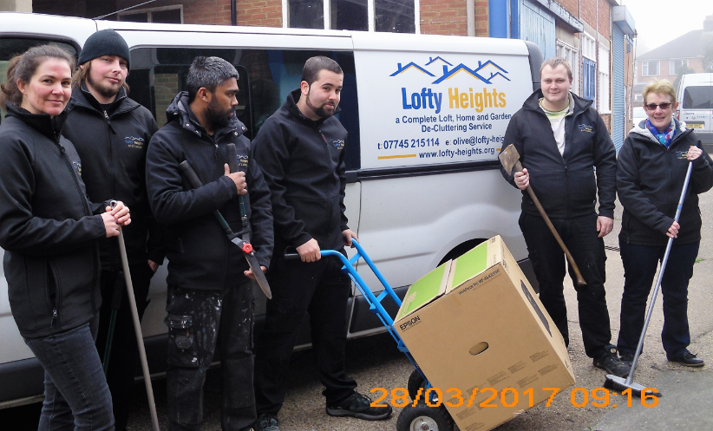


Slide 2



Slide 4

Sheltered Housing Findings
Customers Want:
Customers Don’t Want
To know more but in a way THEY choose to access
They want visits and coffee mornings (think time share sales)
To know the price and locations of schemes
Consideration when they move – changing ovens or décor to suit their individual needs
To be rushed – could you realistically move in under 7 days?
To put people out – this includes family, friends or you – the nice person from housing…
To say ‘No’ – Remember that they might say ‘yes’ to something unrealistic

Slide 7

Olive Quinton
01473 345301
olive@lofty-heights.org
www.lofty-heights.org

