Slide 1

Dementia-Friendly Housing Charter
Vanessa Pritchard-Wilkes
Housing & Care 21
Sara Miles
Alzheimer’s Society
Notes:
Both Vanessa & Sara
Introduction to the speakers
Vanessa’s role
Sara’s role
Why we are doing the seminar … to raise awareness of the housing charter and to ensure that we reach those occupations which we need to.

Slide 2
What we will cover today
Prime Minister’s Challenge on dementia
Why is housing important to people living with dementia
Vision and scope
Involving people with dementia
Charter content
Case studies
Committing to the Charter
Notes:
SPEAKER NOTES:
Whilst going through the webinar, make a reference to what has just been discussed / what the new section will focus on e.g. “we have just explored...now we will look at...” This will ensure that it has a clear narrative
At the end summarise the main points of the presentation

Slide 3
2012
20 communities working to become dementia friendly
10% of England covered by a Local Dementia Action Alliance
Low awareness and understanding
Low Local Authority engagement
2017
240 communities working to become dementia friendly
75% of England is covered by a Local Dementia Action Alliance
Nearly 2 million Dementia Friends
55 Local Authorities currently registered under DAA and DFC
Prime Minister’s Challenge
How far have we come?
Notes:
Sara

Slide 4
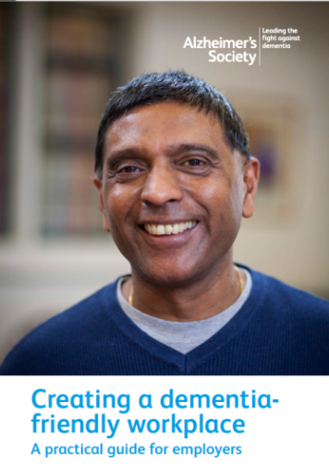
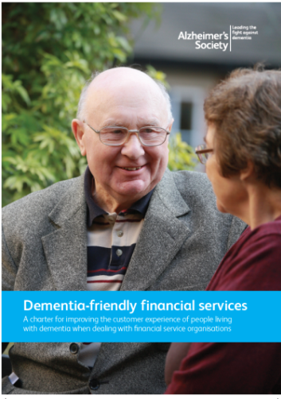
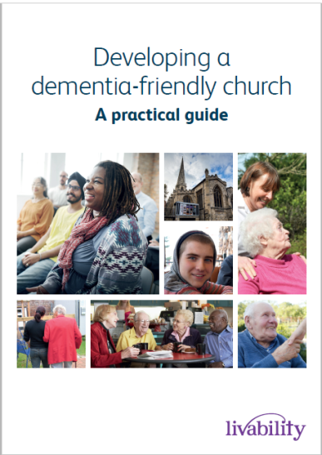
Previous guides and charters
Current outputs:
  Dementia-friendly housing charter
  Dementia-friendly Financial Services Charter
  Dementia-friendly Employers’ Guide
  Dementia-friendly Arts Venue Guide
  Dementia-friendly Technology Charter
  Accessing and Sharing Information publication
  Dementia-friendly Retail Guide
  Dementia-friendly Church Guide
Upcoming projects / outputs:
  Dementia-friendly Heritage Guide
  Dementia-friendly Cinema Guide
  Dementia-friendly Air Transport
  Dementia-friendly Sport Venues Guide
Notes:
Sara

Slide 5
Why is housing important to people living with dementia?
Two-thirds of people with dementia live in the community, mostly in mainstream housing
People with dementia in the community want support to help them maintain their independence
It is widely recognised that much of existing housing is poorly suited to the needs of older people and people with dementia in particular
Where people with dementia have moved into specialist housing they identify benefits
Housing with care can plays an important role in supporting people with dementia and fill a gap between mainstream homes and care homes
Home truths: Housing services and support for
people with Dementia (2012)

Slide 6
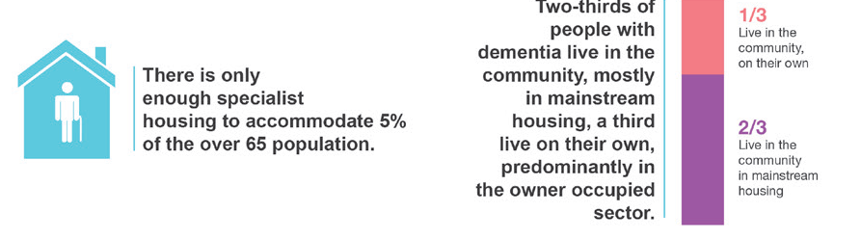
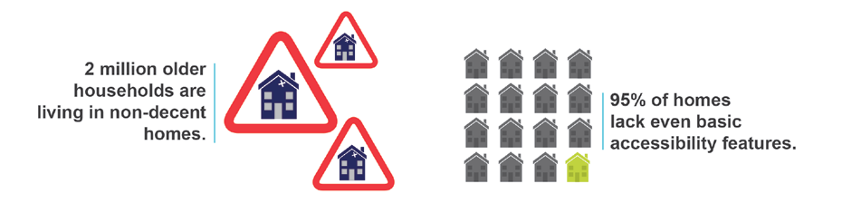
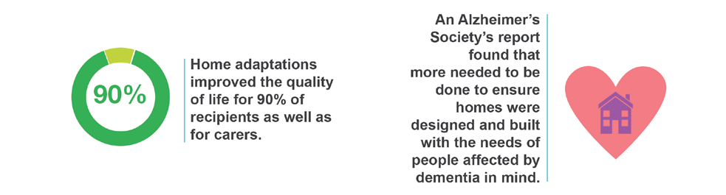
Key facts

Slide 7
What ‘home’ means to people with dementia
Connectedness
Actively personalising and creating home
Control over decisions about how and where we live
Locality - the importance of familiarity; the sense of connection to people and places
Cultural expectations and needs
Beyond the Front Door (2016) Life Story Network
Notes:
Connectedness - Many people referred to home as a place of family - a place where they had brought up their children; ‘my first home when I got married’, a place where family could come to. ‘Home is where my family are’, said one woman from Irish Community Care
Actively personalising and creating home - The personal nature of home was described as both the place where ‘you put your stamp on it’ and ‘home is what makes a person’.
Control over decisions about how and where we live - One group described how not being able to make your own decisions made a place ‘unhomely’. They felt that living in your own home but with someone else’s rules, can feel belittling. Some people raised concerns about how decisions were made about what possessions should move with the person. One person described how her children made decisions about what moved with her.
Locality - the importance of familiarity; the sense of connection to people and places - People were clear that home is a place where meaningful activity takes place - ‘You stop at a hotel, but you live at home’. Developing new routines and activities has given some people a new lease of life. One participant related her feeling that the housing scheme had enabled her to incorporate her previous life into her current one and this gave her place a sense of homeliness. Retaining routines that have been part of lives for years remain important anchors.
Cultural expectations and needs - The home is associated with status, for example, for the head of the family. This was explained by Somali Elders – home is a place where ‘people listen to us and ask our advice’. ‘Once you are out of the house, you are just anybody’. For others, it is a place where family and friends gather for significant events such as birthdays, weddings and funerals.
Some people described situations where established tenants had been unwelcoming and this had made their transition difficult.

Slide 8
Vision and scope of the charter
To engage with a wide range of stakeholders within the housing sector to encourage increased awareness of the contribution of housing to the challenges posed by dementia.
To provide the relevant resources and examples of good practice to encourage their integration into all aspects of people (staff), places and processes.
Aimed at the full range of professionals working in the housing sector, from planners and architects to landlords and developers, housing managers and handypersons.
Designed to help all professionals support people
living with dementia in their homes and facilitate
consistency and good practice.

Slide 9
Involving people with dementia in this charter
Attending Service User Review Panels across the UK to understand what was important to people living with dementia when it comes to housing.
Key points were:
To be enabled to live where you are familiar and are happy living
Design – wet rooms, few steps, open plan layout, signage, sockets at arms level
Technology - Provide sensors/alarms for cooking, sensor lights
Staff need to have knowledge and a broad awareness of dementia
Accommodation needs to meet people’s needs as their dementia progresses and needs to be suitable for adaptations to
be made as needed.

Slide 10
Successes of this charter
Evaluation factored in from the beginning
Working document
Very clear focus
Included a broad range of organisations
Used existing network for launch and dissemination
Involving people with dementia to shape the commitments
Notes:
Note on evaluation: COULD MOVE THIS TO THE END
Planning the evaluation over the summer to recruit people for an Autumn evaluation of the charter (Sept onwards). We are committed to evaluating this resource and would be grateful if you would like to get involved. Please look out for further information regarding this or get in contact. Evaluation will consist of:
Interviews – quick calls (20 minutes)
Following up with people who have signed up. How useful has it been? If not, why not? What changes have you implemented as a result?
Acting on feedback e.g. the barriers faced - Why is this an issue?
Considering a spread of e.gs with differing experiences. Eg. Private / Public / Regular

Slide 11
Heading
Bringing together existing resources and research
Aimed at:
Supporting people with dementia to live independently
Helping housing professionals in their support of people living with dementia in their own homes
Provides access to:
The knowledge to plan and prepare for future projects, developments and services by influencing initial design and planning of future housing stock
Knowledge and resources to make relevant ongoing adaptations and repairs to current housing stock to support people with dementia
Showcases:
Case studies across the sector

Slide 12
Case studies
Waltham Forest HA
A small, locally-based housing association providing predominantly sheltered housing. As many as 14% of their tenants live with dementia. To become more dementia-friendly, they have:
Appointed Dementia Champions
All staff on the Board and the main contractors became Dementia Friends
Audited properties as part of estate inspections and support planning resulting in an internal action plan
Set up Waltham Forest Dementia Action Alliance
introduced the Sunshine Club to raise awareness with tenants at fun sessions
Developed a dementia-friendly specification for works on empty properties
Incorporated dementia design into our cyclical and planned maintenance programmes.
Leyton Orient FC, have dedicated a match to raising
awareness of dementia for three years.
Notes:
Vanessa to take over
appointed Dementia Champions – operational and strategic – who lead the integration of dementia into all work processes rather than treat it as a separate topic
internal action plan was developed which is reviewed and updated regularly (at least every six months)
Sunshine Club - they meet once a month for activities such as a pamper sessions, arts and crafts, fitness and black history celebrations

Slide 13
Case studies
Midland Heart
Provides and maintains 32,000 homes - a mix of general needs, specialist housing, and support and care services.
The organisation has taken a holistic approach to being dementia-friendly by:
Developing a dementia strategy;
Raising awareness among staff, residents and communities through imaginative events;
Developing roadshows with its customer panel
Employing external trainers for specialist staff
It is also now exploring the potential for a partnership approach to training and supporting staff with Worcester University’s Association of Dementia Studies.
It also makes use of a 1950s dementia pod to stimulate memories and conversation; and is looking to train staff in
‘design and build’ principles via Stirling University.

Slide 14
The three pillars
People | Places | Processes
Staff who manage properties; Landlords People providing services such as modifications and adaptations Repairs Home maintenance Handyperson services Architects and planners | The creation and maintenance of suitable housing which incorporates space and design can support people living with dementia. Includes the interior and exterior of buildings | Housing systems and infrastructure used in all residential provision, planning, design and development and housing-related services such as repairs, maintenance, adaptations and management. Processes designed to reduce barriers.

Slide 15
Stakeholders
Stakeholders | Explanation | Occupations
Designing and building | From inception through design to ready to occupy | Planners, architects, building control, facilities or property management, designers, developers.
Managing and supporting | The daily running activities of all housing tenures | Landlords, developers, housing managers, occupational health, facilities or property management.

Slide 16
Stakeholders (continued)
Stakeholders | Explanation | Occupations
Modifying and adapting | The modification, repair and adaptation of housing and the built environment to meet changing needs | Occupational therapists, community equipment or telecare providers, handypersons, environmental health officers, home improvement agencies, builders, technical officers and architects

Slide 17
Commitment Statements
People
To identifying people affected by dementia who need support
To understanding the needs of people
To signposting/navigation/advice and information
Place
To navigation / setting
To raising awareness
Processes
To applicability
To communication
To greater information and support for people with dementia to access housing options

Slide 18
Commitment Statements
Place
Commitments to navigation / setting
The services required for people to stay in their own homes are not widely known and therefore not accessed or offered | Staff need to know what options are available locally for care and support at home.
There is a lack of appropriate adaptations in properties to provide a more dementia-friendly environment | Communication of the principles and ways for home adaptations to be more dementia-friendly (for example Alzheimer’s Society ‘Making your home dementia-friendly’ and Stirling University booklet ‘10 helpful hints for dementia design at home’). Ensure dementia design principles (and other relevant design) are incorporated, including people living in their own homes.
Notes:
NHS choices website

Slide 19
Why sign up to the charter?
Demonstrate leadership within the sector by proactively addressing the societal challenges posed by an increasing incidence of dementia
Increase awareness of how dementia and its challenges affect the services and products which an organisation offers
Ensure that the needs of customers are met in a consistent and appropriate manner
Create an organisation in which customers feel comfortable discussing their needs
Be perceived by partners as dementia-friendly which may enhance reputation
Notes:
Currently over 220 recognised Dementia Friendly Communities in England and Wales covering over 26million people.
At our current rate we are set to cover over half of the population by 2020.
To become a DFC you have to set up a local infrastructure or group, set an action plan to focus on at least one of the British Standards Institute Areas for Action (Transport, Health and Social Care, Community incl Faith and Voluntary, etc).
This means that these communities are committed to social action to improve the lifes of people affected by dementia across the country.
Schemes are happening from gyms, swimming pools to leisure centres, to theatres cinemas and music venues, to train bus stations and taxi companies.
All aspects of society and community are covered.

Slide 20
Committing to the charter
Sign up to the Housing Charter and commitments
Sign up through the Alzheimer’s Society website
Publicly announce delivery on the relevant Charter commitment statements
Specific actions to be incorporated into the Dementia Action Alliance action plan, if applicable.
Deliver the commitments specific to your stakeholder group within a set, individually determined and planned time-frame
Select a senior member of staff to champion the initiative and ensure that the appropriate delivery plan is established and progressed
Evidence and report back on progress and outcomes of the identified commitment statements.

Slide 21
What can you do now?
Sign up to the charter via Alzheimer’s Society website alzheimers.org.uk/housingcharter
Make a plan for your colleagues to become Dementia Friends – register your organisation at dementiafriends.org.uk/register-partner-admin
Sign up to Dementia Words Matter and find out more through the Dementia Voices website.
If you can help us to engage with relevant housing sector organisations and to disseminate the Dementia Friendly Housing Charter, please email
sara-jane.little@alzheimers.org.uk
Notes:
A note on Dementia Words matter:
DEEP has published a new guide on the language used to describe dementia. The guide is intended for use by journalists, organisations and communications departments.
Dementia is discussed more regularly now in the media – both on television and in newspapers and magazines. The language we use to talk about dementia influences how people with dementia are viewed and also how they feel about themselves. People with dementia prefer words and descriptions that are accurate, balanced and respectful.

Slide 22
Acknowledgements
Members of the Prime Ministers’ Champion Group for housing
Alzheimer’s Society
Housing & Care 21
Anchor
ARCO
Care & Repair England
Guinness Partnership
Pozzoni
Housing LIN
Keepmoat
McCarthy & Stone
Members of the Dementia & Housing Working Group
National Housing Federation
Royal Town Planning Institute
Tunstall
Your Life
Causeway Service User Review Panel
Chichester Positive thinkers
League of Minds
North Somerset Living With Dementia Group
South Eastern/Belfast SURP group

Slide 23
Questions?
Vanessa.pritchard-wilkes@housingandcare21.co.uk
Sara.miles@alzheimers.org.uk

