Slide 1
Joining Forces to Reinvent Sheltered Housing in Suffolk
Paul Kingston
Director of Housing and Care Services
Orwell Housing Association
Together we make a difference

Slide 2
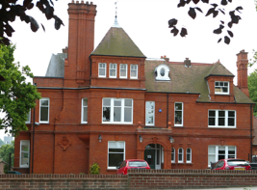

Orwell Housing Association
Traditional housing association, formed in 1963
3,600 properties in ownership and management, 800 of which are Sheltered and Supported Housing
600 permanent staff, 100 relief, 38 volunteers
Mainly in Suffolk, but also covering Norfolk, Cambridgeshire and Essex
Turnover £44m
Overall satisfaction 92%
Head Office

Slide 3
Sheltered Housing Schemes in Suffolk
Number of Schemes
184
Number of Providers
24
Number of Units 4534
Figures as of March 2016

Slide 4
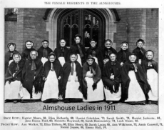
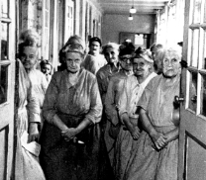
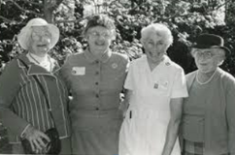
History of Sheltered Housing
936 - first recorded alms-house is founded
1132 - the oldest alms-house still in existence built
1348 - Black Death triggers an expansion of charitable housing foundations
1571 - Hospital for aged or injured soldiers and their wives built
Late 1800s - the provision of large scale social housing by local authorities
1945 – Hearth & Home founded, providing shelter for elderly people following the blitz. First home opens 1947.
900
1000
1100
1200
1300
1400
1500
1600
1700
1800
1900
2000
1536 poor laws passed paving the way for the first public poor house
1834 - Poor Law Amendment Act initiates massive programme of workhouse building
1900s - private nursing homes began to appear
Mid 1970s - demand identified for a private sector equivalent to the well-established local authority sheltered housing schemes

Slide 5
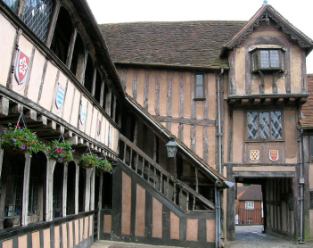
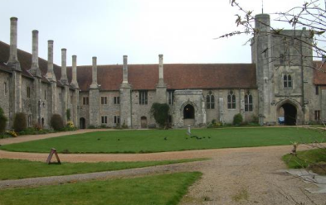
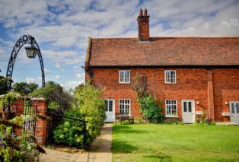
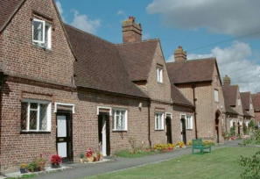
Hospital of St Cross, Winchester
Lord Leycester Hospital, Warwick
Mary Warner Alms-houses, Woodbridge
Sir Robert Hitcham Alms-Houses, Framlingham

Slide 6

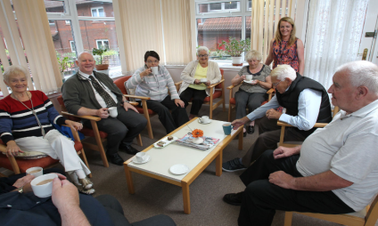


Slide 7

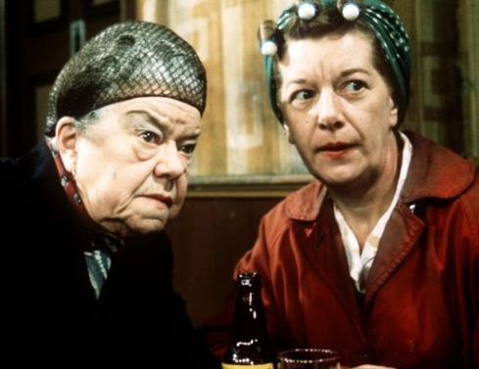


Peoples expectations may have changed but I still believe it has a valuable role to play.
Has Sheltered Housing gone out of fashion?
Together we make a difference

Slide 8




Slide 9
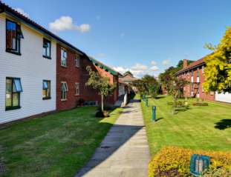
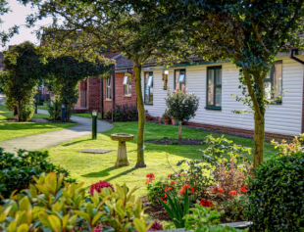
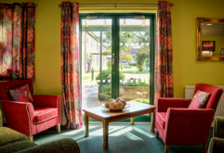
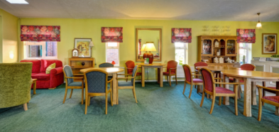
The Good
Together we make a difference

Slide 10
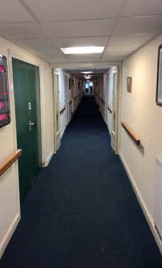
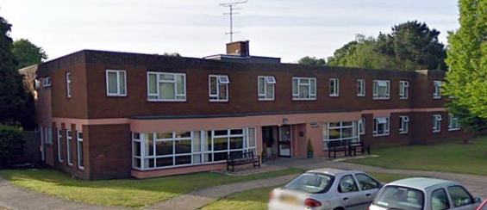
The Not So Good
Together we make a difference

Slide 11

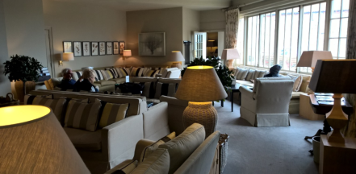
Even Better!
Together we make a difference

Slide 12
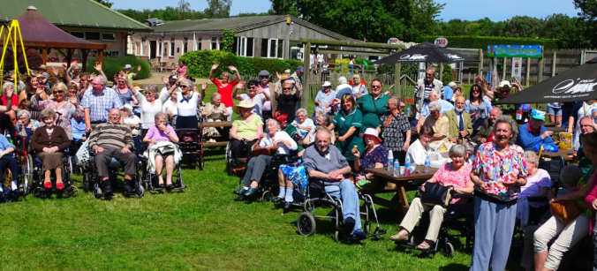
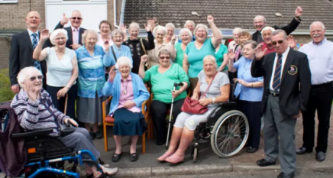
Together we make a difference

Slide 13



Together we make a difference

Slide 14


Disclaimers signed by Orwell tenants
18%
Disclaimers signed by Flagship tenants
38%
Together we make a difference

Slide 15
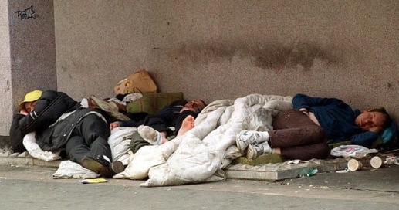

The Alternative?
Together we make a difference

Slide 16


What does it cost?
£139.92 per week
Blimey! That’s ASDA prices!
Together we make a difference

Slide 17

How are Orwell Sheltered staff paid for?
18 %
Rent
40 %
Service Charge
42 %
HRS Funding
Together we make a difference

Slide 18


Together we make a difference

Slide 19


LHA for Sheltered Housing
£476 pcm
LHA £392 pcm
Together we make a difference

Slide 20



Together we make a difference

Slide 21


Together we make a difference

Slide 22

Together we make a difference

Slide 23
The Proposal
Employ a team of 7-10 staff, including management.
Monitor people not engaging with existing services by telephone and visits.
If needs are increasing, encourage the person to access existing services or signpost them to alternative forms of help and support, including care services.
Existing providers can also refer people to the service for a second opinion, advice and guidance regarding alternative housing, support and care services.
Together we make a difference

Slide 24

Sheltered Housing deserves investment, a stable funding regime and to be valued as a preventative service.
Together we make a difference

Slide 25


Thank you for Listening
Together we make a difference

