Slide 1
Building Partnerships and Reducing Demand through Telemedicine
Rachel Binks
Nurse Consultant – Digital & Acute Care
Airedale NHS Foundation Trust

Slide 2


Digital Health
Telecare
Telecoaching
Telemonitoring
Teleconsultation

Slide 3
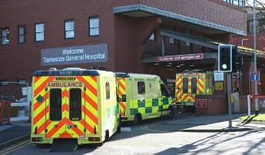

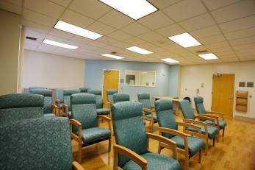
A system designed by default
Some people seem to do quite well without waiting for healthcare support…

Slide 4
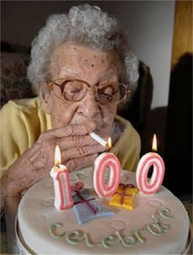

Slide 5
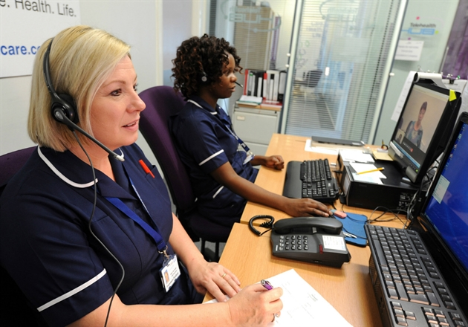
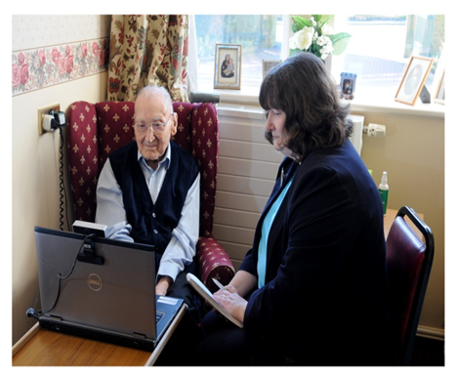
Telemedicine Service
Teleconsultation by secure video link between nursing and residential homes and the Airedale Digital Hub.
Providing clinical consultation not a logarithm based approach like 111.
Hub based at Airedale Hospital staffed by team of 27 senior clinicians 24/7
Triage and assessment of all requests for GP visits in hours (Additional service called GP Triage)
Fully managed technical service utilizing bespoke lap tops with HD cameras and with 4G SIM or Broadband

Slide 6
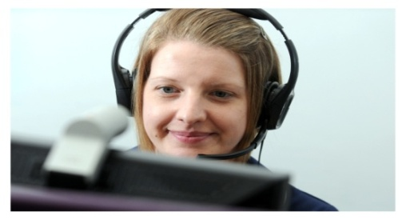
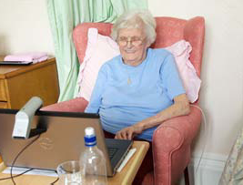

right care today
Teleconsultation
Prison health care
Care at home
Nursing & residential care
Supporting end of life patients
24/7 clinical hub
improving patient experience
changing patient flow
reducing costs
Electronic shared record
  connecting primary & secondary care now
  connecting whole health & social care economy tomorrow

Slide 7
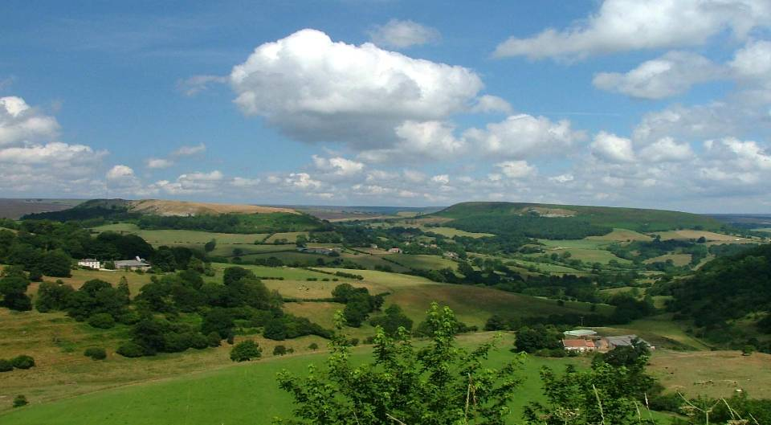
right time – care anywhere

Slide 8
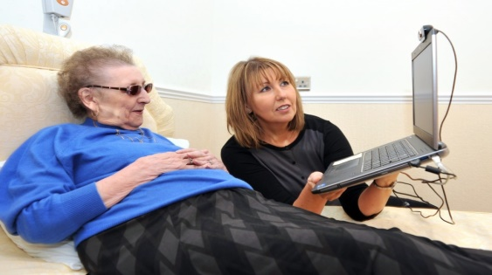
right place - replicable model
475 Nursing/Residential Care Homes + 50 in implementation
Supporting > 18,000 residents
19 CCG contracts
YTD 18495 clinical video consultations

Slide 9
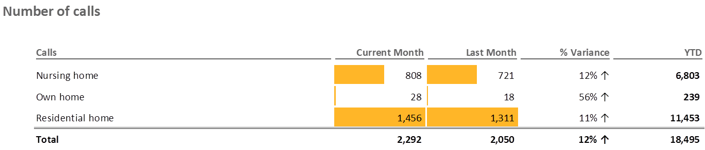
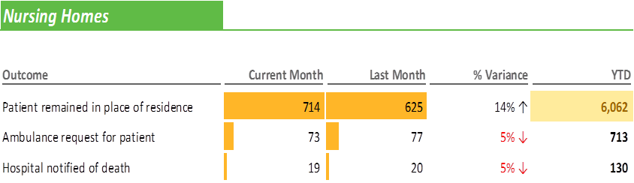
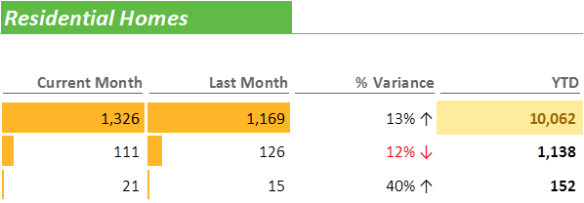

Slide 13
Medication/Prescriptions

Slide 14
Reasons for call

Slide 15
Intention vs actual

Slide 16
Outcome

Slide 17
Other services delivered from the digital care hub
Shared record
Registered practitioners
Visual contact
Gold Line
GP Triage
Intermediate Care Hub
Acute Care Team
Single Point of Access
Complex Care Team

Slide 18
GP feedback
"Of all the changes in the 15 years I have been working this is the greatest change which has reduced workload I can remember. I don't mind the extra "late" duty doc visit as this is more than made up in the drop in other visits. A big thank you to all involved."

Slide 19

Video insight into our
Gold Line Service
http://www.health.org.uk/gold-line

Slide 20
Setting the scene in EoL care
Approx. 1% population die each year
We need to identify people who are approaching the end of their lives because….
Identification leads to opportunities for care planning and improves outcomes
Requires skilled communication
Most people would prefer to die at home but many still die in hospital

Slide 21
Place of Death
1700 patients with GL died in the year ending March 2016
1380 had place of death recorded and available to us
Place of Death | Gold Line | England (Dec 2015)
Home | 34% | 23%
Care Home | 25% | 22%
Hospice | 24% | 6%
Hospital | 14% | 48%

Slide 22
From 5100 calls, regarding 1813
patients

Slide 23
% deaths in hospital AWC compared to England 2012-2015

Slide 24
Deaths in Usual Place of Residence

Slide 25

Building on our innovation
What will the future look like?
New models of care:
“…in some places the future is already emerging, for example in Airedale…”

Slide 26
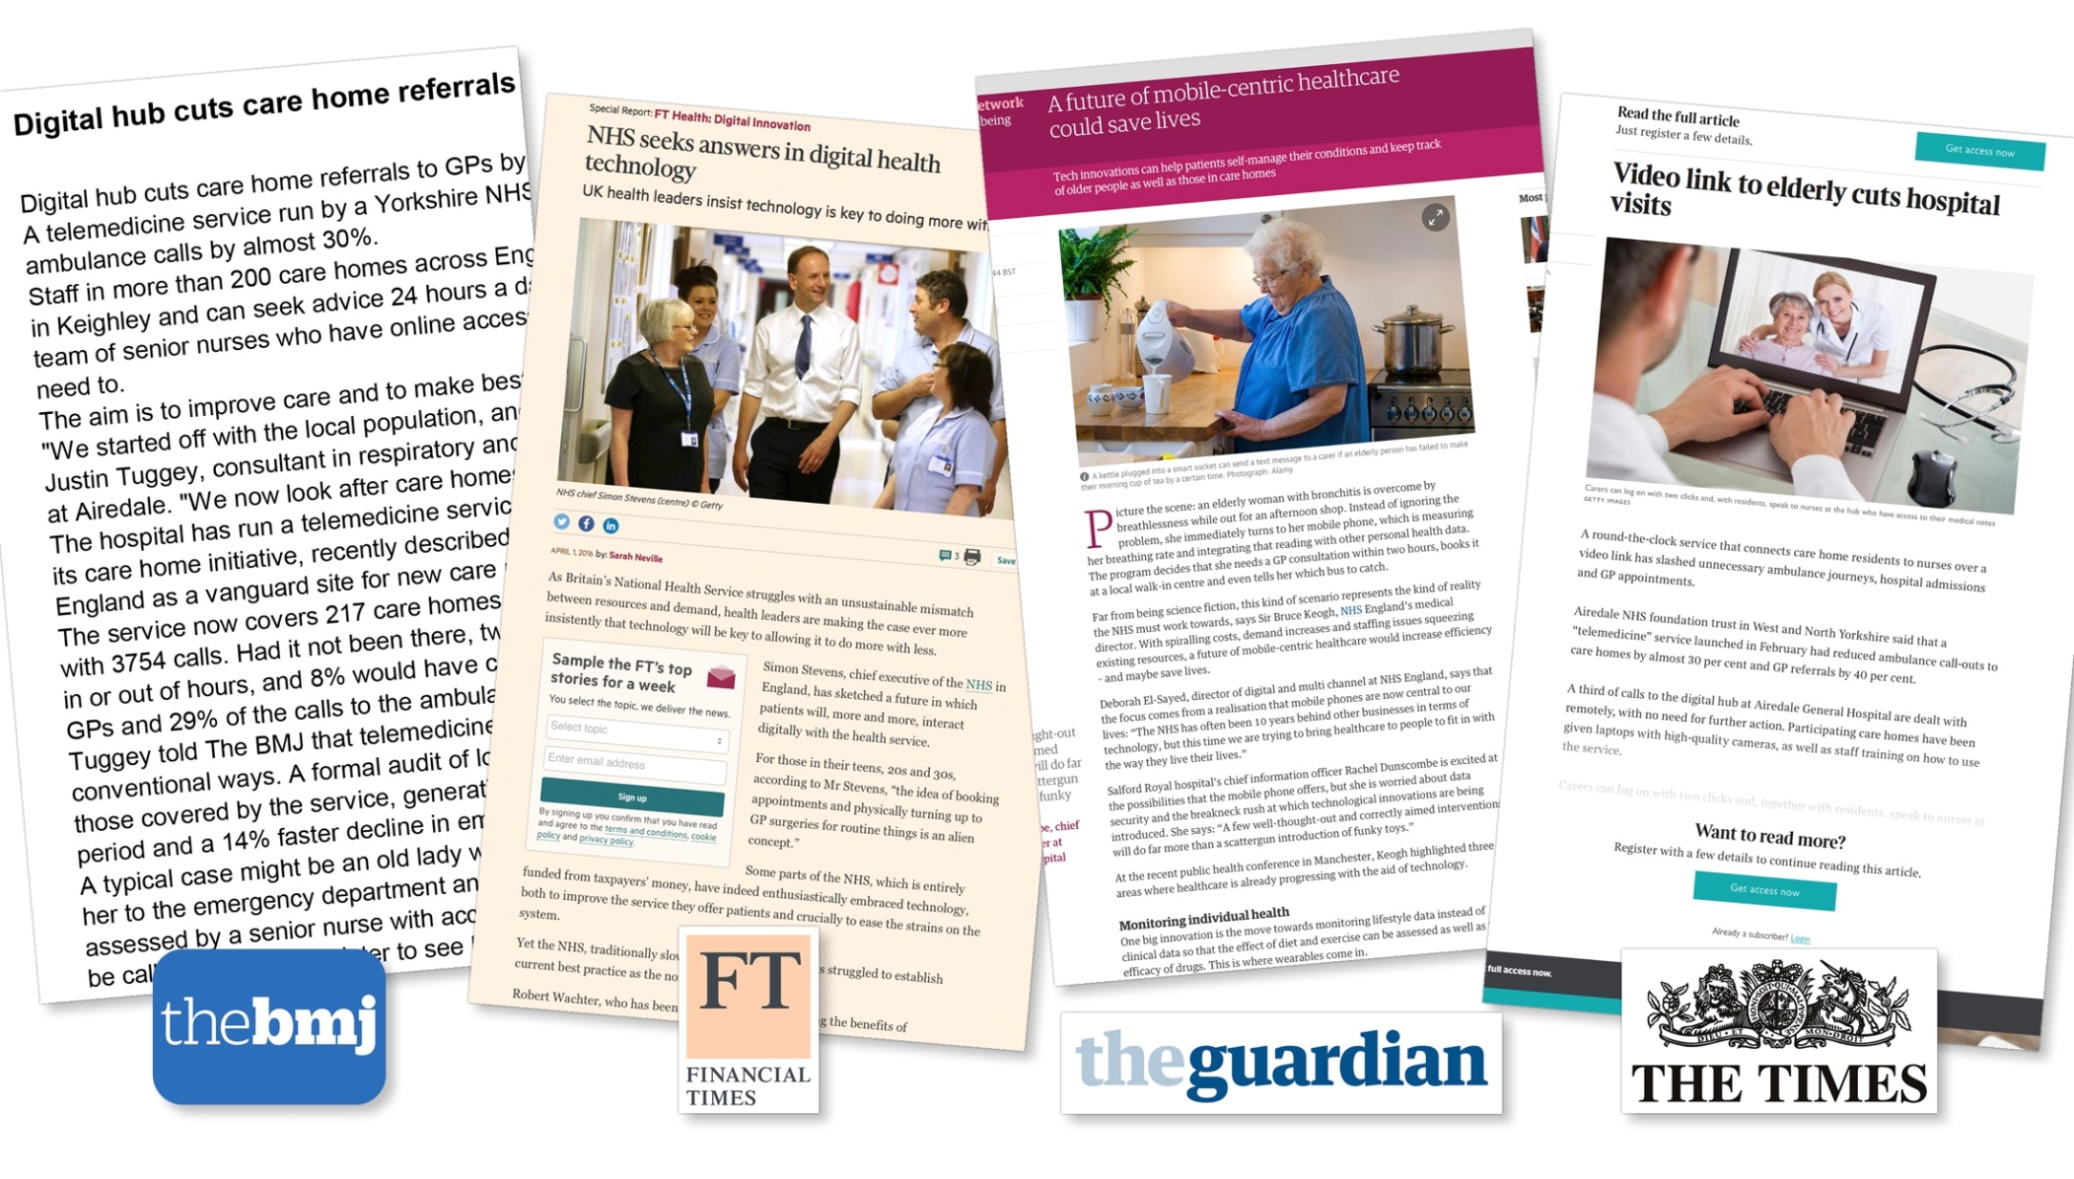
Growing national media interest
in what we do

Slide 27
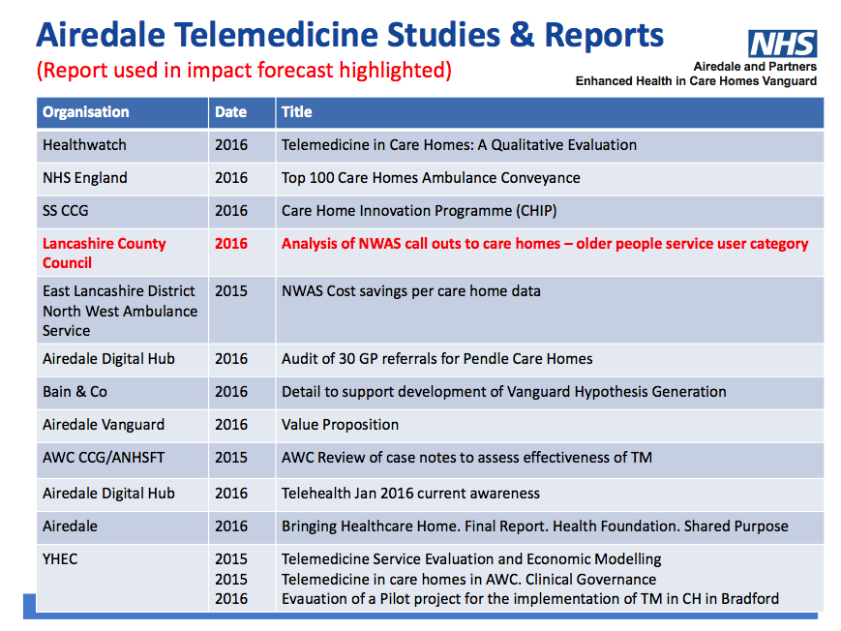

Slide 28
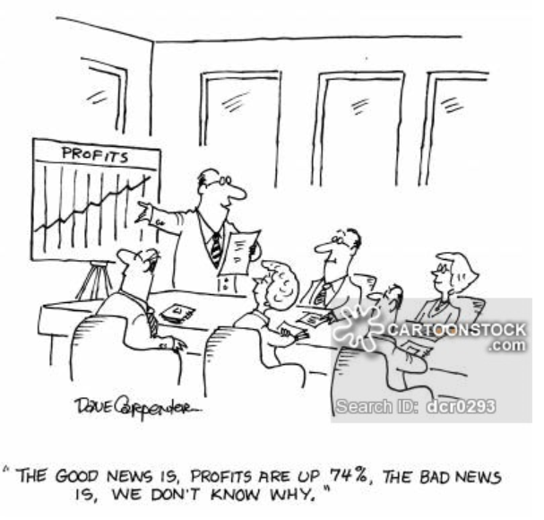
Impact …

Slide 29
Impact on GP Services (Month 10 16/17 YTD)

Slide 30
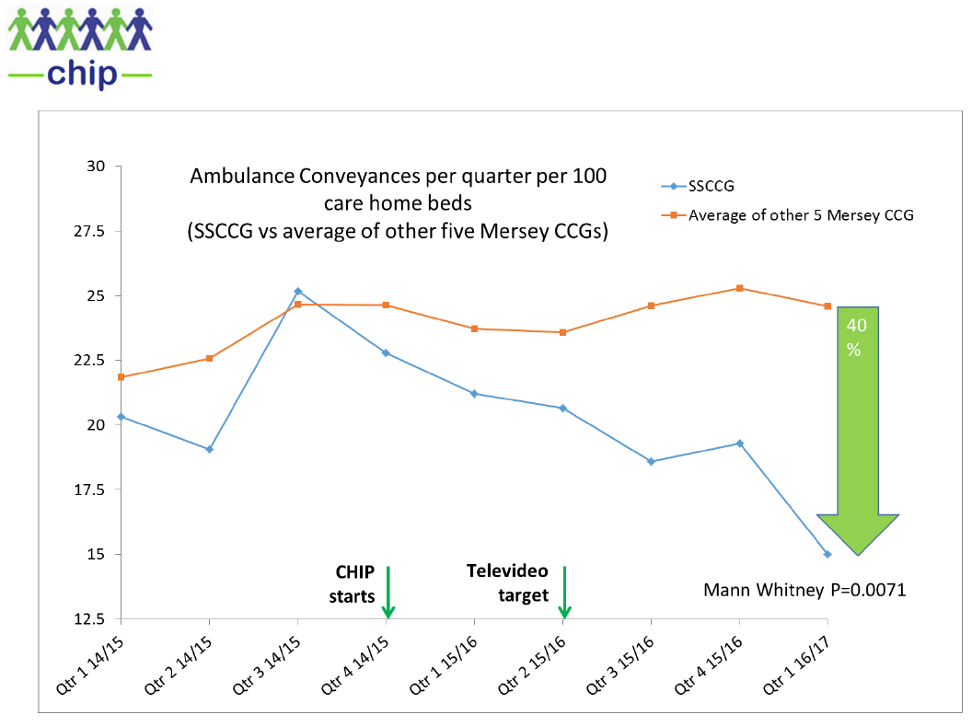
South Sefton CCG Care Homes Innovation Programme

Slide 31
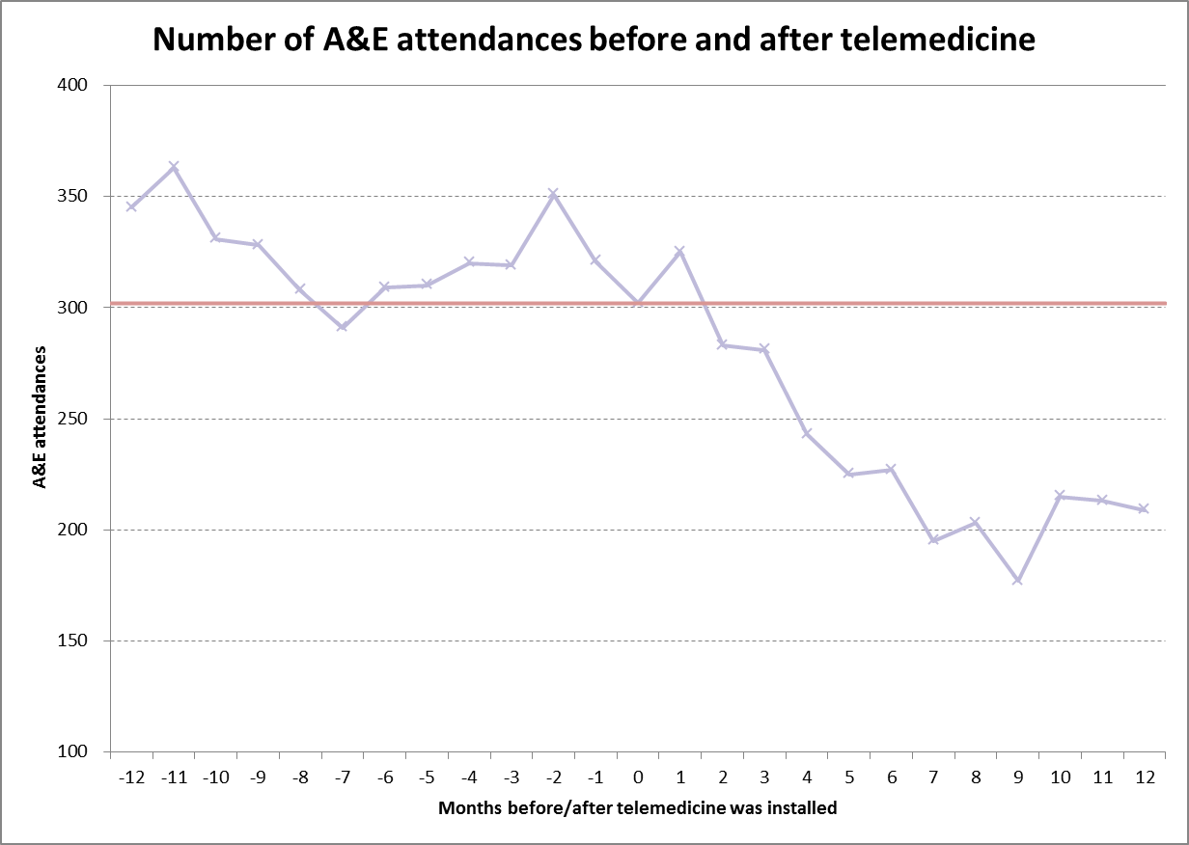
Care Homes in Bradford and Airedale
circa 130 homes Impact
Demonstrates circa 33% reduction in A&E attendances 12 months after installation
A wide range of home installation dates are all aligned as month 0

Slide 32
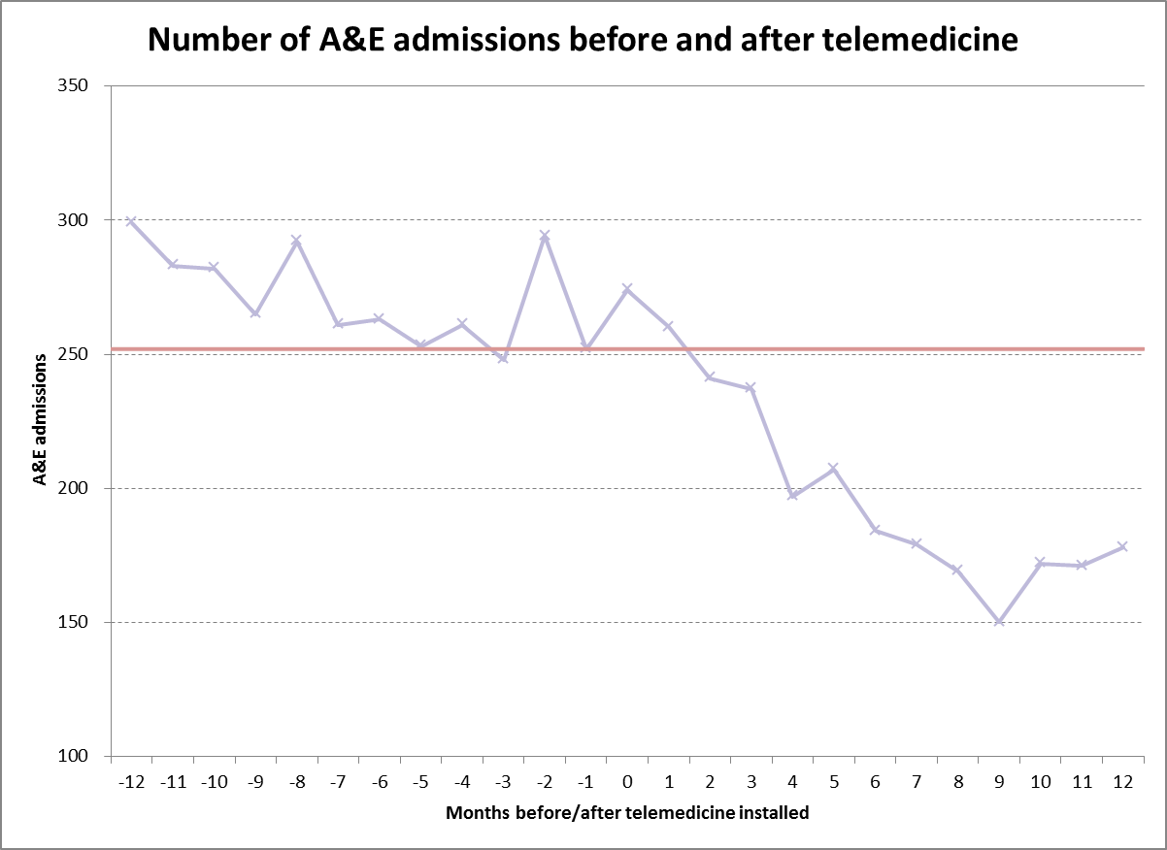
Care Homes in Bradford and Airedale
circa 130 homes Impact
Demonstrates circa 25% reduction in admissions via A&E 12 months after installation
A wide range of home installation dates are all aligned as month 0

Slide 33
Airedale Wharfedale Craven CCG care homes impact (n=51)
Compares Unplanned Care Activity before and after installation

Slide 34
Further potential
Primary Care enhancement – called GP Triage
  In hours, care homes are prevented from requesting GP visits direct from GP Practices and must make a video-call to the Digital Hub for patient assessment
  This service is changed at an additional £2,400 per home/year. Currently provided in circa 100 homes in East Lancashire, Dudley and Aylesbury.
GP Video access to care homes via APP (extensive trial commencing in East Lancs April 17)
MDT conferencing with Community Nurses, GPs, Digital Hub and Care Homes
Virtual Training to Care Home Staff (already available in Bradford and Airedale)
Provision in patient’s own home
  Identification of patients at high risk of hospital admission or readmission
  Proactive Digital Hub care management via care plans
  Linked to Community Nursing and GP care
  Move equipment between high risk patients at 6 week intervals to improve cost effectiveness
Diversion from NHS 111 and 999
  Non emergency calls are intercepted and passed to the Digital Hub for assessment and management

Slide 35
Innovation potential
“The innovation that telemedicine promises is not just doing the same thing remotely that used to be done face to face, but awakening us to the many things that we thought required face to face contact, but actually do not.”
David D Asch MD, MBA,
Perelman School of Medicine, University of Pennsylvania

Slide 36
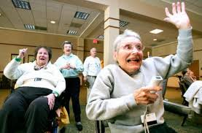
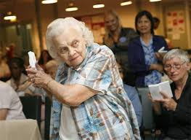
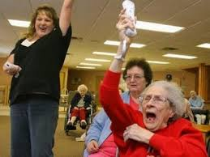
Questions
Technology Enabled Health
– the art of the possible…

