Slide 1
Telecare: is it a problem or a solution? Findings from the UTOPIA (Using Telecare for Older People In Adult Social Care) online survey of English Local Authorities
Dr John Woolham
Senior Research Fellow

Slide 2

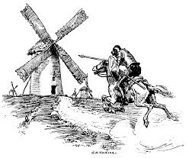
Structure
Definitions
Background: context to the UTOPIA study
UTOPIA: objectives and methods
Findings
Issues arising
This presentation summarises independent research by the National Institute for Health Research School for Social Care Research. The views expressed in this presentation are those of the author and not necessarily those of the NIHR SSCR, NHS, the National Institute for Health Research or the Department of Health.

Slide 3
1. Definitions
Assistive Technology
‘any item, piece of equipment, product or system, whether acquired commercially, off the shelf, modified or customised, that is used to increase, maintain, or improve functional capabilities of individuals with cognitive, physical or communication difficulties’
Marshall et al (2000) p. 9.
Telecare
‘the use if communications technology to provide health and social care directly to the user/patient. This excludes the exchange of information solely between professionals, generally for diagnosis and referral’
Barlow et al 2007 p.172.
Purpose
To reduce the risk of adverse events
To monitor individuals (vital signs, falls, flood, etc)
Physical assistive technologies to aid mobility
Information and advice & to support medication & self care
To support independent living
  Knapp et al. (2015) unpublished
Functions
To remind or to prompt
To support communication
To support meaningful use of leisure time
To promote comfort and well-being
To help keep people safe
  AT Dementia website www.atdementia.org.uk

Slide 4
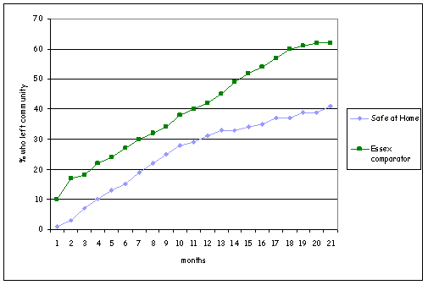
2. Background & context to the UTOPIA study: early projects and evidence
Falkirk Mobile Community Alarm service
Northampton Safe at Home Project
Adre ‘n’ Saff (Anglesey)
Croydon Aztec Project
Kent
Edinvar Housing Association
Gloucester smart home
Signal project (Leicester)
Hard to upscale from project to service – the Audit Commission, ICES, CSIP

Slide 5
2. Background & context to the UTOPIA study: telecare strategy and policy guidance
Green Paper (2005) more general mood music about technology being useful – but not just for frail older people - and in ‘unlocking resources’ as well as helping people remain independent.
2005 –willing the means rather than just the ends: Building Telecare Guidance & The Preventive Technology Grant (PTG). 80m over 3 years for all English local authorities.
    To pump prime and stimulate demand
    Good for industry which was seen as needing help
    Came with strings: PIs which encouraged local authorities to get telecare and electronic assistive technologies into homes of as many older people as possible.
Recognised the need for better research: commissioning the Whole System Demonstrator.

Slide 6
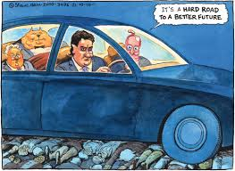
2. Background & context to the UTOPIA study: public sector austerity
Adult Social Care Department budgets not protected
Cuts of between 25-40% since 2009
No end to austerity and reduced public sector spending
Telecare seen as a less expensive way of meeting needs
  Signposting of non-eligible people
  Service of ‘first resort’ - before care or as a substitute for care
  To keep people out of hospital
  To facilitate early discharge
  To prevent/delay admission into care
Telecare as prophylactic and panacea?

Slide 7
2. Background & context to the UTOPIA study: summary
Governments have seen a key role for assistive technology for two decades
Implementation has been difficult because of formidable barriers & lack of an infrastructure at a local level to support the widespread use
Much work was done to promote the wider use of assistive technology and telecare
The Government to some extent willed the means as well as visioned the future for telecare with the PTG and PIs.
The Government commissioned the WSD to fill the gap in evidence for impact and effectiveness.
Public sector austerity has led to a renewed interest in telecare as a cost effective way of providing help to people needing adult social care.

Slide 8
2. Background & context to the UTOPIA study: The Whole System Demonstrator project (WSD)
Largest clinical trial of telecare and telehealth in the world.
Robust RCT design.
Large samples, reliable & generalisible findings.
Data on wide range of outcomes collected over a 12 month period to determine if telecare made a difference.
Trial cost = approx. 4m.
Based around 3 ‘demonstrator sites’: Cornwall, Newham & Kent.
5,806 people randomly assigned to telecare intervention group or control (2,903 each) from 217 general practices.

Slide 9
2. Background & context to the UTOPIA study: WSD findings
Some, fairly limited evidence of positive impact of telehealth applications
No evidence for that telecare made a difference
Steventon et al. (2013) compared outcomes for telecare users with a controlled, randomised group people who received no telecare.
None of the measured outcomes were statistically significant
  ‘In this trial, telecare did not significantly alter rates of health or social care service use or mortality over 12 months’
Steventon et al. (2013 p.6)
 | Control (n=1, 236) | Intervention (n=1,190)
Admission proportion (%) Mortality (%) Emergency hospital admission per head Elective hospital admission per head Outpatient attendance per head A&E visits per head Falls admissions per head Hospital bed days per head GP contacts per head Practice nurse contacts per head Proportion admitted into permanent residential care (%) Domiciliary care weeks per head Hospital tariff costs per head GP surgery costs per head Social care costs per head | 49.2 8.9 0.57 0.41 3.80 0.70 0.11 8.48 6.63 3.21 3.2 15.36 2,604 315 4,287 | 46.8 8.7 0.65 0.38 3.92 0.72 0.14 8.65 6.72 2.80 3.1 15.41 2,846 305 4,210
WSD criticisms
Ignored pre-existing practice in the 3 sites – damaged goodwill amongst local agencies needed to run effective telecare services
Follow-up was only 12 months
Many people recruited may not have had a level of need for which telecare might have made a difference over the follow up period

Slide 10
2. Background & context to the UTOPIA study: telecare: a new policy problem?
WSD findings = problems for:
The Government: current policies support the development of service provision offering no advantages over traditional care & support
Local authorities, some of which have invested v. large sums at a time of unrelenting budgets cuts
Telecare manufacturers: ability to offer shareholder dividends jeopardised if care industry dis-invests.
Telecare ‘pioneers’ and early evaluators whose results were very positive
Investment case studies:
Birmingham, (14m) Hampshire, (20m) North Yorkshire, (3.5m?) Hertfordshire, (5m?) Manchester & Newcastle
ADASS response to Better Care technology Survey (2014)
‘This is an important survey which…will support members to generate further momentum in realising the potential for assistive technology….We hope our investment in resources to support members with their telecare service development can now be focused in the areas that make the most difference’
(Dave Pearson, ADASS President 2014)

Slide 11

3. The UTOPIA study: objectives and methods
Accepts the ‘currency’ of the WSD and the quality of this research whilst understanding its limitations
Seeks to understand why Local Authorities have not scaled back investments, and why WSD findings seem to have been ignored.
  What might explain the findings of the WSD? Can the findings all be explained away & ignored because of supposed and real flaws in design and methods?
  Is Local Authority evidence of impact and outcomes a better source to rely on?
  Should Local Authorities accept the findings of the WSD and work out what they need to do to ensure telecare delivers better outcomes?
Objectives: to understand Adult Social Care Departments (ASCDs) perspectives about:
What strategic aims is telecare is intended to serve for older people?
What local evidence is being collected to enable ASCDs to assess if these are being achieved?
How these aims are operationalised and delivered? (Taking as a ‘given’ best current evidence that use of telecare may not necessarily produce better outcomes, to explore reasons for this: e.g. barriers and facilitators).

Slide 12
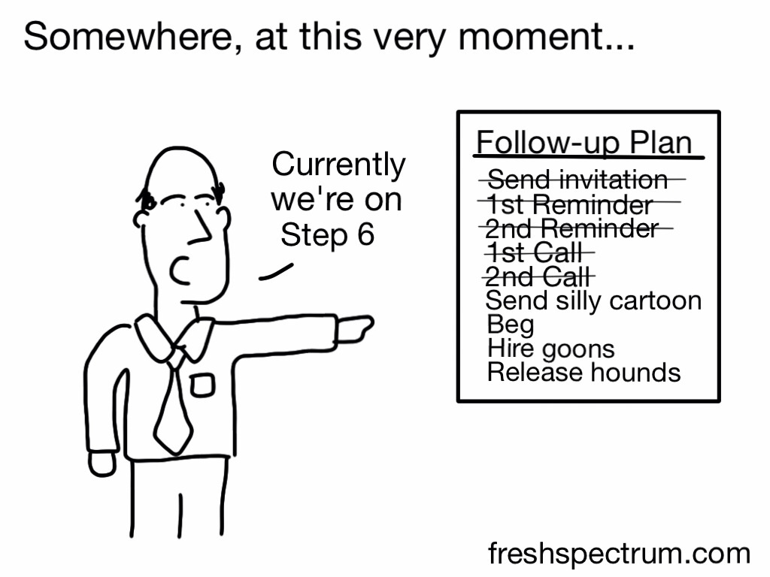
3. The UTOPIA study: objectives and methods
Online survey using ‘ Survey Monkey’ online software
Questionnaire designed by research team with input from advisors
Promoted by various means
  NCAS conference by presentation
  Email to all 152 DASS and reminder 21 days later to non-respondent LAs
  Article in ADASS bulletin
  Article in Housing & Telecare LIN Newsletter
  Bulletin posted on National Care Forum
  Portal on SCWRU website
  Blog written for Community Care online
  Approached all 152 English Adult Social Care Departments. 156 surveys were completed
114 valid responses (75% response rate)

Slide 13
3. UTOPIA Findings
Strengths
Excellent response rate
All types of Council and region represented in the return
Limitations
Not all questions answered by all participants
Unidentified but valid responses assumed to be ASCDs or organisations commissioned by them

Slide 14
3. UTOPIA Findings
1. Awareness and use of research evidence to support telecare use
Half said telecare was informed by research evidence
Almost a third were not aware of the Whole System Demonstrator project findings
Lively comments to a question asking for opinions about findings from the Whole System Demonstrator project
2. Strategic aims for telecare in ASCDs
Over 60% said their ASCD telecare strategy was not produced collaboratively with NHS/Health partners
Better Care Fund did not seem to be a particular focus
Main way in which telecare was intended to support strategic aims (delaying needs for support and enhancing quality of life) was risk management and safety, and support for unpaid carers

Slide 15
3. UTOPIA Findings
3. Achieving strategic aims
Half ASCDs used code and standards developed by TSA.
A quarter said they planned to seek accreditation in the future.
4. Barriers and Facilitators
Barriers:
Awareness of the public of telecare
Knowledge/skill of users and carers of how to adjust/reset telecare
Skills to assess for telecare
Availability of sufficiently wide range of devices
Concern about loss of face-to-face contact through telecare use
Facilitators:
Little professional resistance or concerns about ethics
Installation skills
Social response arrangements

Slide 16
3. UTOPIA Findings
5. Level of financial commitment
40% felt telecare would save money but not all could evidence this claim
Some had done some financial modelling and developed hypothecated savings
A third had a specific spending target for telecare.
6. Assessing eligible older people for telecare: what gets considered?
High proportions answered affirmatively to questions about the kinds of things covered in assessments

Slide 17
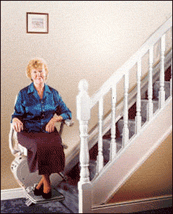
3. UTOPIA Findings
7. Assessing older people for telecare: who assesses, for what?
Formal assessments of need for telecare not always done
  Some devices available without need for assessment
  Some circumstances require rapid deployment (e.g. hospital discharge)
  39% said older people can self-assess and 52% that they could spend their DP on telecare
  Advice was available in half of ASCDs to support self-assessed or private purchasing decisions
Care Managers, specialist telecare workers and OTs all assess for telecare
Assessing how people interact with home environment not always possible
Assessments done in a range of non-home settings.
8. Assessing older people for telecare: reviews and the assessment tool
Only a fifth of ASCDs used what they felt was a validated telecare assessment tool
Reviews were often done by telephone and sometimes focused on the equipment rather than the person

Slide 18
3. UTOPIA Findings
9. Training
Over 80% said training was available to telecare assessors
This was usually on-the-job or by telecare manufacturers
Almost no training was formally accredited or led to a formal qualification
The length of the training course or session was usually short
Focus of much training was on how devices worked

Slide 19
3. UTOPIA Findings
10. What telecare is available?
Most ASCDs relied on a small number of telecare suppliers
The three most commonly used devices were
  Pendant alarms
  Fall detectors
  Bed/chair occupancy sensors
  29 types of device were mentioned in total but some were not telecare

Slide 20
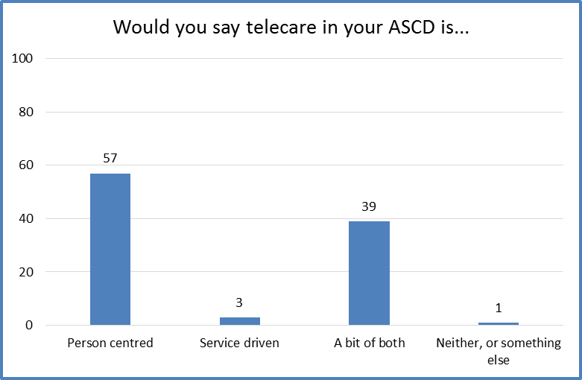
3. UTOPIA Findings
Over half said telecare use was ‘person-’ rather than ‘service’ centred, but over a third felt it was a bit if both
Reasons:
For those who felt the ASCD was person-centred:
Assessments believed to be tailored to individual needs, goals and aspirations
Not about need but choice
No one-size-fits all or standardised packages
Or those who felt it was a bit of both:
Because sometimes the needs of service users cannot be met fully because of the capacity of the service
Limited range of devices available
Need to achieve a greater shift in cultural attitudes of staff
Two types of telecare service offered: basic packages and specialist.

Slide 21
3. UTOPIA Findings
11. Installation and maintenance
A wide range of local agencies were involved in installation, maintenance, initial and mobile responses but overall proportions were low
Telecare was most commonly installed and maintained by specialist telecare workers and telecare manufacturers or suppliers
Over half said that maintenance was based around devices programmed to alert a call centre when servicing was needed
Reasons for requesting telecare to be removed were changes in need, failure to ‘get on’ with devices and concerns about costs and charges
12. Responding to information generated by telecare
Just under half said the ‘first line responder’ was an unpaid carer
Most Shire counties did not have a 24/7 paid response service.
A quarter of this group said that if no-one could be found to act as a responder telecare would not be provided
Not all ASCDs seemed to be making full use of data generated by telecare devices

Slide 22
4. UTOPIA Issues
Use of research evidence: what and how?
Limited involvement of NHS and other health partners & Better Care Fund
Should strategic focus be so much on risk management and safety?
Does telecare support carers or add to carer burden?
How important is it that ASCDs adopt certified standards?
How to promote facilitators and minimise barriers?
What are the circumstances in which it’s OK to use telecare without an assessment and when is it essential?
Who should assess for telecare? What matters?
Is access to a range of telecare sufficient?
Can person-centred approaches to telecare use be compromised: e.g. by remote assessment, access to a limited range of devices or the absence of mobile response service?
Is there a need to develop better training for telecare staff?
How to ensure people who self-assess and use Direct Payments or private funding make the right decisions for them?

Slide 23
Selected references
Audit Commission (2000) Fully Equipped: the provision of equipment to older or disabled people by the NHS and Social Services in England and Wales. Abingdon, Audit Commission Publications.
Barlow, J., Singh, D., Bayer, S., & Curry, R., (2007) A systematic review of the benefits of home telecare for frail elderly people and those with long term conditions. Journal of Telemedicine and Telecare 13 172-179.
Bjorneby, S, et al. (1998) Technology Ethics and Dementia. Sem, Norway. Norwegian Centre for Dementia Research.
Department of Health (2001) The National Service Framework for Older People London, Department of Health .
Department of Health (2005) Building telecare in England. London Department of Health.
Fisk, M. (2003) Social alarms to telecare Bristol, Policy Press.
House of Commons Select Committee on Health (2002) Delayed Discharges Third Report of Session 2001-02 Cm5645 London, The Stationery Office
  Knapp, M, Barlow, J, Comas Herrera, A, Damant, J, Freddolino, P, Hamblin, K, Hu, B, Lorenz, K, Perkins, M, Rehill, A, Wittenberg, R, & Woolham, J. (2015) The case for investment in technology to manage the global costs of dementia. (2015) PIRU, LSE, PSSRU.
  Marshall, M. (ed.)(2000) ASTRID: a Social and Technological Response to meeting the needs of Individuals with Dementia and their Carers. London, Hawker Publications.
McColgan, G, & Bowes, A, (2009) Smart technology and community care for older people: innovation in West Lothian, Scotland. Edinburgh, Age Concern Scotland.
Mitchell, R., (unpublished) (1996) Mobile Emergency Care Dementia Project An Evaluation. Falkirk Social Services
  NHS (1998) An Information strategy for the modern NHS 1998-2005 London, Department of Health.
House of Commons Science and Technology Committee (2005) 1st report of session 2005-06. Ageing: Scientific Aspects HLP20 London, The Stationery Office.
Royal Commission on Long Term Care (1999) With Respect to Old Age: Long term care – rights and Responsibilities (Cm4192-1 London, the Stationery Office
Secretary of State for Health (2000) The NHS plan: a plan for Investment, a plan for Reform CM 4818-1 London, HMSO.
Secretary of State for Health (2005) Independence Wellbeing and Choice: Our vision for the Future of Social Care for Adults in England Cm6499, London, the Stationery Office.
Steventon , A, Bardsley, M, Billings, J., Dixon, J, Dioll, H, Beynon, M, Hirani, S, Cartwright, M, Rixon, L, Knapp, M, Henderson, C. Rogers, A, Hendy, J, Fitzpatrick, R, & Newman, S, Effect of Telecare on use of health and social care services: findings from the Whole Systems Demonstrator Cluster randomised Trial (2013) Age and Ageing 42 (4) 501-08.
Wey, S., (2005) One size does not fit all: person centred approaches to the use of assistive technology. In Marshall, M., (ed.) Perspectives on Rehabilitation and Dementia pp 201-210 London, Jessica Kingsley.
Woolham, J, (2005) The Safe at Home Project London, Hawker Publications.

